Slide 1


Final project Group E
Grace Boyle
Alberto Martínez
Abanoub Nagy
Notes:
This is the cover template
You might change just the title and the team members names (do not change fonts or colors here)
In case you collect some videos together in a longer one, use this as introductory image (5 seconds)

Slide 2

0. Index
Text styles
To avoid inconsistencies, keep these text styles throughout your presentation. Preserve font and size - color can vary to match your graphic palette if necessary.
Title - Open Sans Normal 36 + Italic
Subtitle - Open Sans SemiBold 24 + Italic
paragraph - Times New Roman 20 + Italic
caption - Open Sans Light 18 + Italic
callout and data in graphics - Times New Roman 14 + Italic
1. Mesh geometries
2. Mesh topologies
3. Stripes method
4. Mesh face topologies
5. Chosen mesh topology
6. Strip planarization
7. Material, process and nesting
8. Connection system
9. Considerations along the project
Grace Boyle, Alberto Martínez, Abanoub Nagy

Slide 3

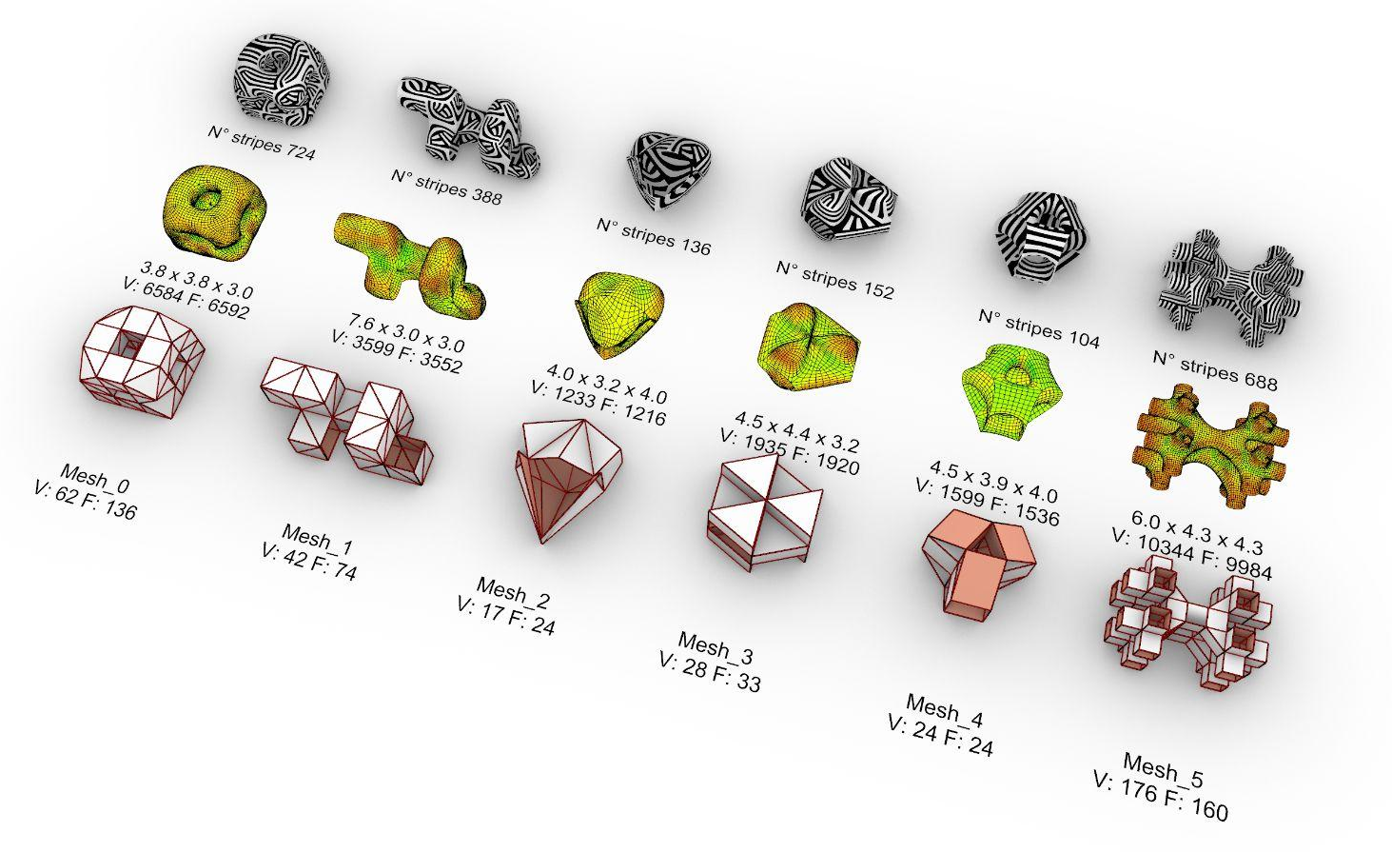
1. Mesh geometries
Low curvature
High curvature
curve radius 0.5
voxel reduction 0.3
28,595,798 Cells
X: 337
Y: 319
Z: 266
Selected: Mesh_4
Well-distributed curvature when smoothed - we might expect a greater structural efficiency at distributing local forces when built
Starting number of faces and vertices not too high
Lower no. stripes for fabrication
Symmetry and inside-to-outside looping geometry has nice potential for flow of stripes and perspective once built
Grace Boyle, Alberto Martínez, Abanoub Nagy

Slide 4
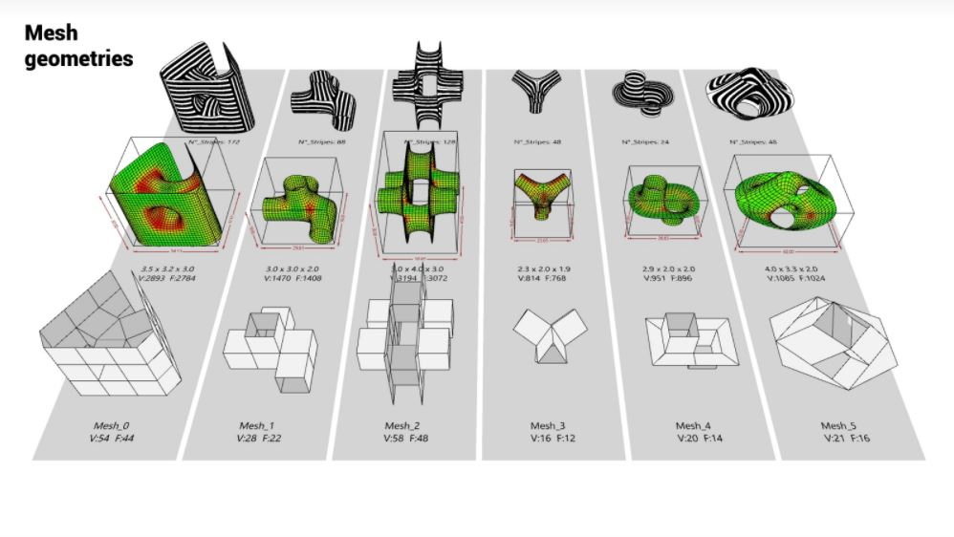
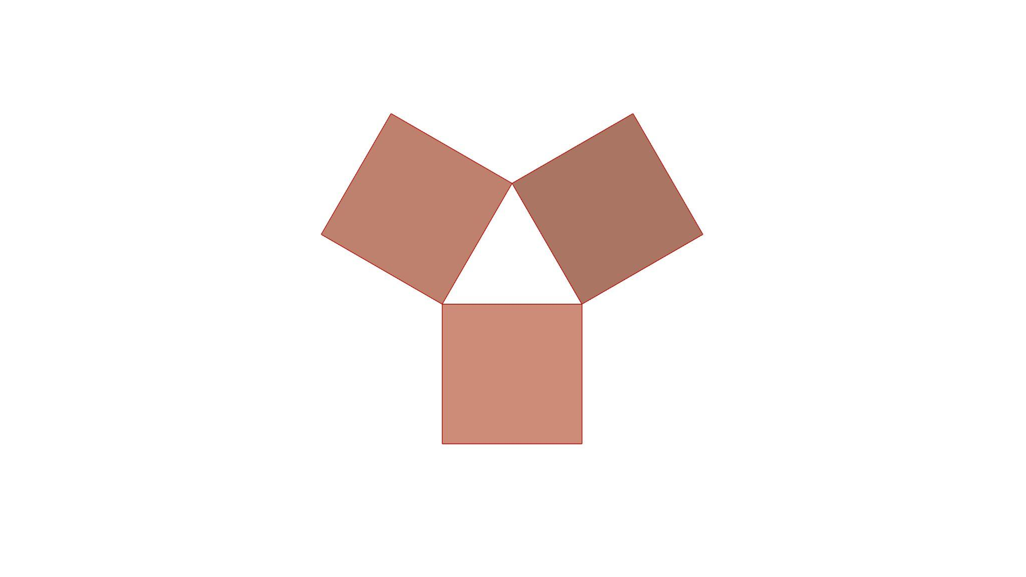
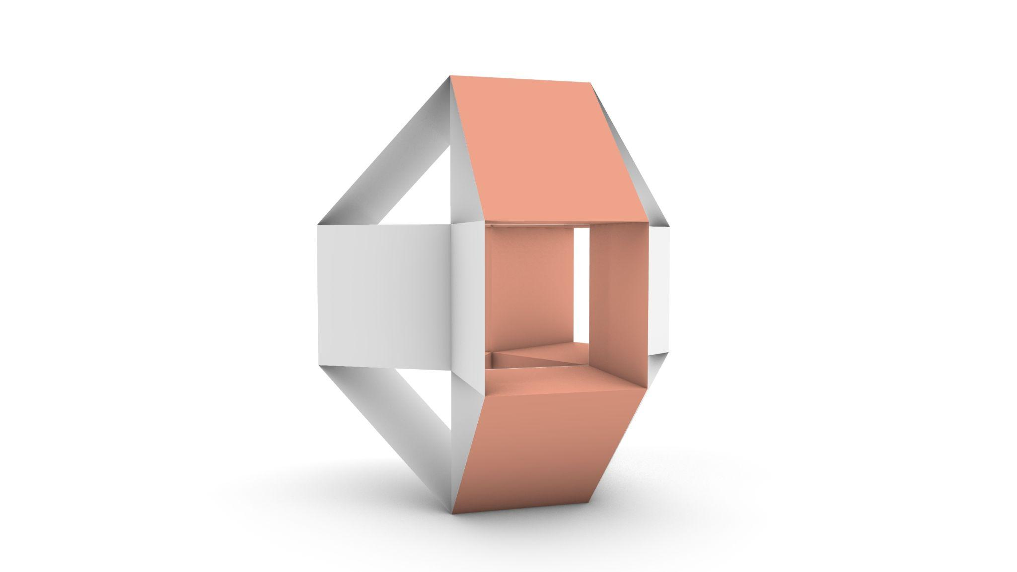
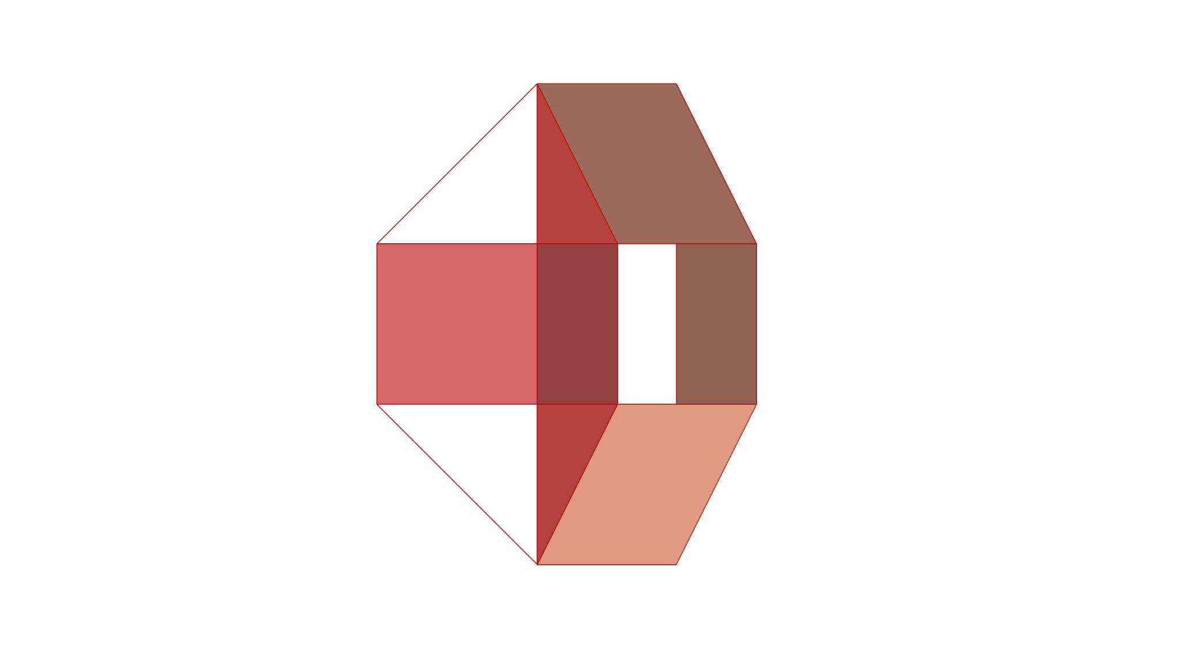
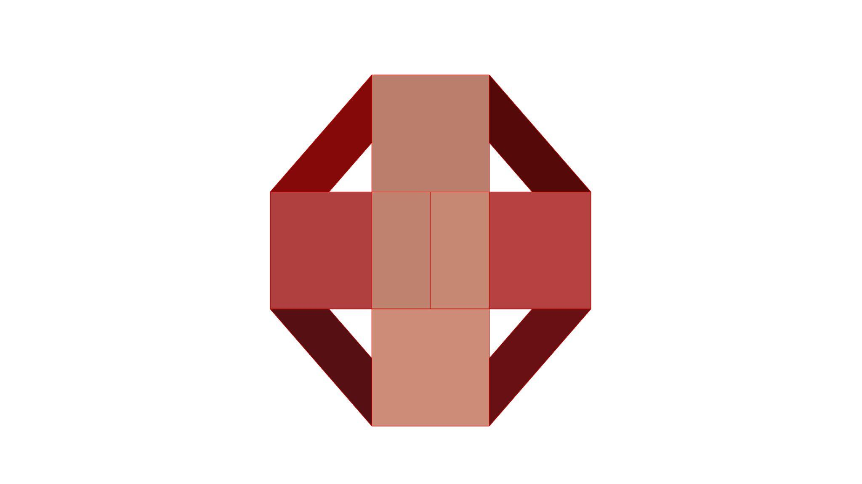
1. Mesh_4
Coarse mesh
Vertices: 24 Faces: 24
‘Loop’
curve radius 0.5
voxel reduction 0.3
28,595,798 Cells
X: 337
Y: 319
Z: 266
Top view
Right view
Front view
Angled perspective view
‘Core’
Grace Boyle, Alberto Martínez, Abanoub Nagy

Slide 5
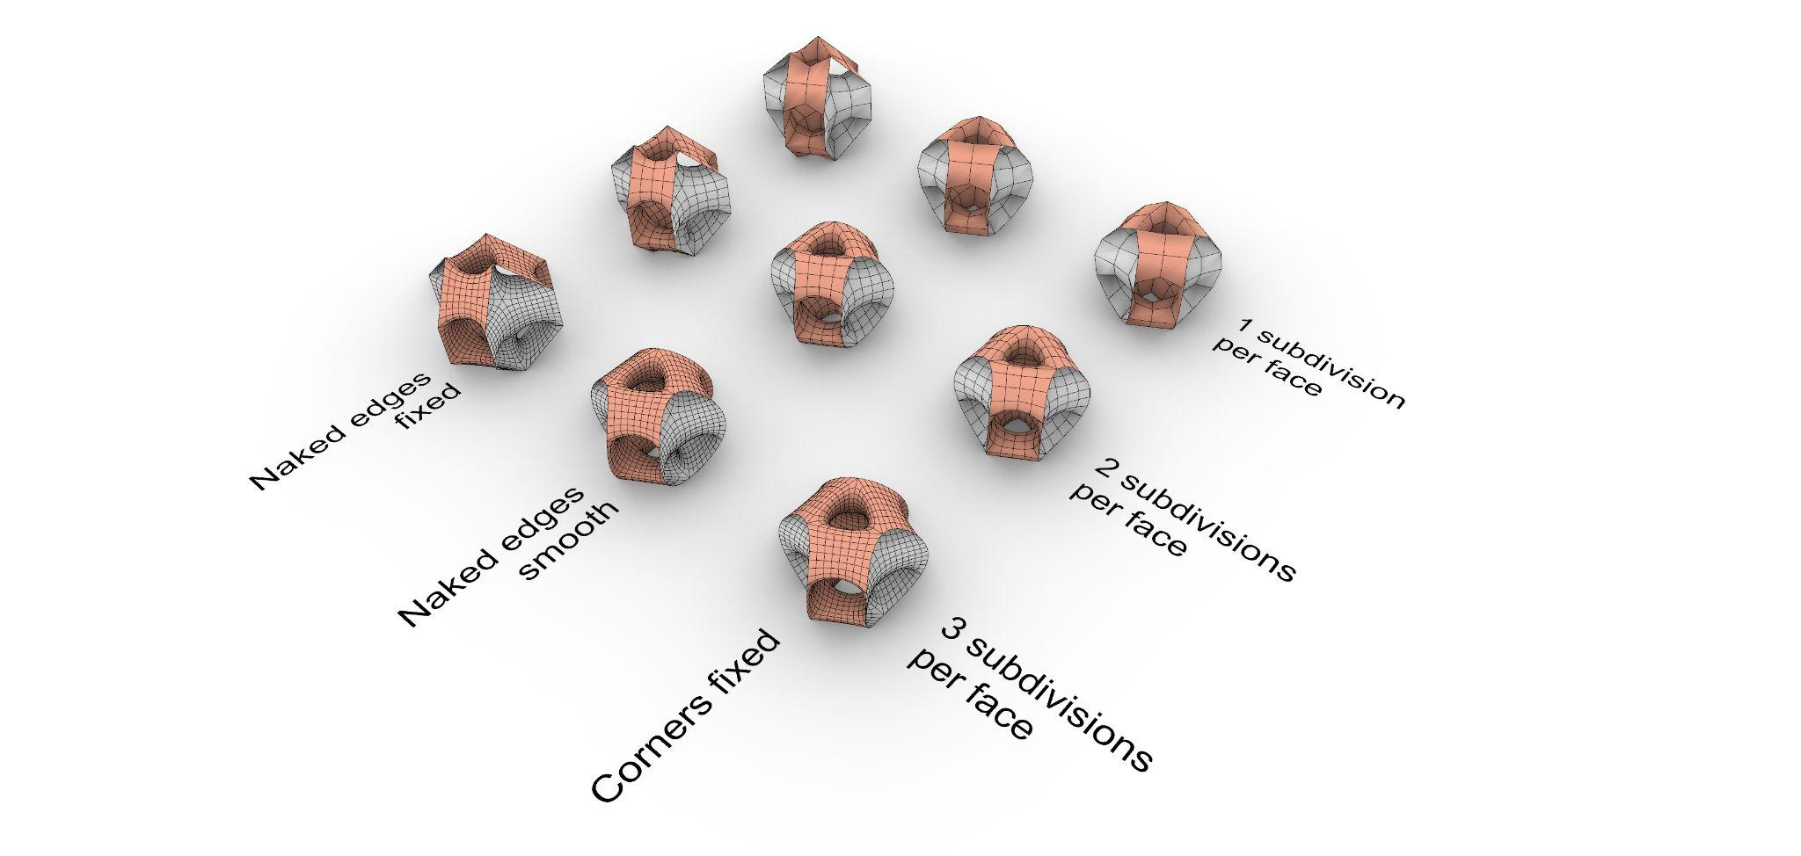
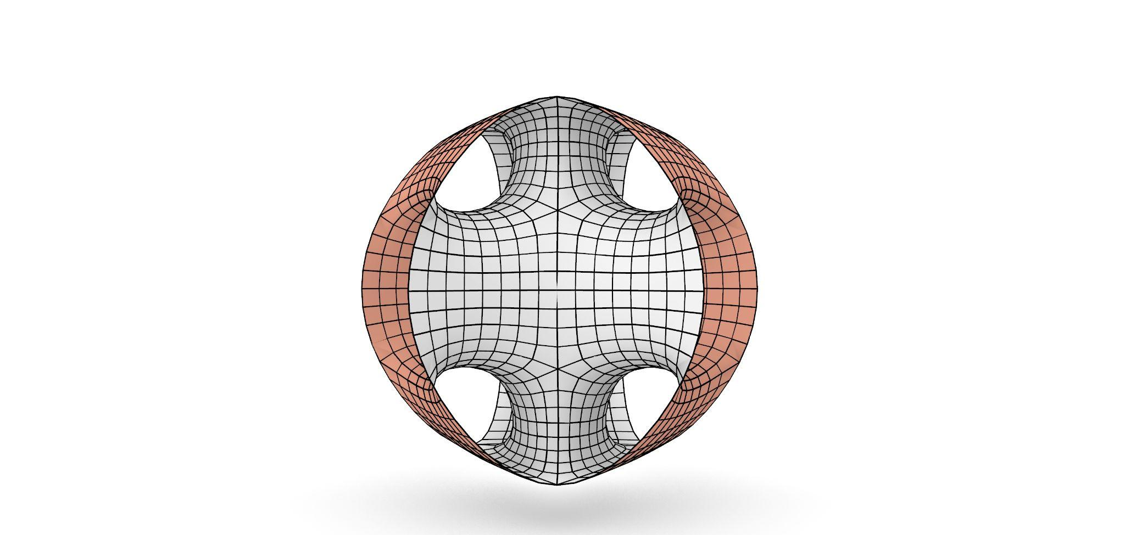
2. Smoothing Exploration
Text styles
To avoid inconsistencies, keep these text styles throughout your presentation. Preserve font and size - color can vary to match your graphic palette if necessary.
Our preferred form has three subdivisions per face, and naked edges smoothed. It appears the most balanced volume.
We are looking for smooth edges overall, to enhance the idea of the geometry as a sphere with openings to different layers of inner chambers.
Smoothed meshes.
Weaverbird’s Catmull-Clark Subdivision, varying parameters
Title - Open Sans Normal 36 + Italic
Subtitle - Open Sans SemiBold 24 + Italic
paragraph - Times New Roman 20 + Italic
caption - Open Sans Light 18 + Italic
callout and data in graphics - Times New Roman 14 + Italic
Preferred mesh configuration: 3 subdivisions per face, naked edges smoothed.
Grace Boyle, Alberto Martínez, Abanoub Nagy

Slide 6
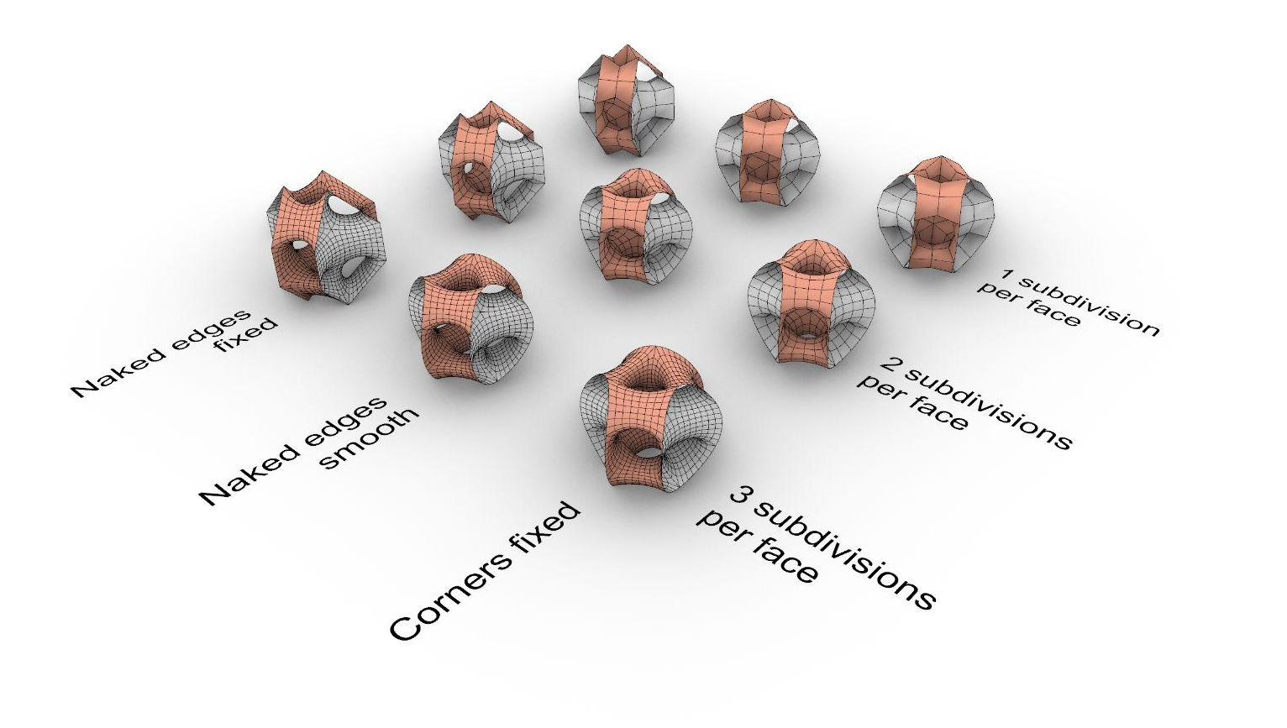
2. Relaxation Exploration
Text styles
Smoothed & relaxed meshes.
Smoothing as on previous slide.
Relaxation via Zombie solver, threshold 0.00001, tolerance 0.0001
Edge lengths: factor 0.7, strength 5
Anchor points: naked boundary edges (783 points).
To avoid inconsistencies, keep these text styles throughout your presentation. Preserve font and size - color can vary to match your graphic palette if necessary.
When the mesh is relaxed, the three loops relax symmetrically outwards from the central triangular tube, but this cannot move.
For this geometry, the effect of relaxation increases curvature / reduces the smooth appearance of the mesh, compared to applying only the Catmull-Clark smoothing.
There appears to be little difference in this effect across varying edge lengths or strength when relaxing.
Title - Open Sans Normal 36 + Italic
Subtitle - Open Sans SemiBold 24 + Italic
paragraph - Times New Roman 20 + Italic
caption - Open Sans Light 18 + Italic
callout and data in graphics - Times New Roman 14 + Italic
Grace Boyle, Alberto Martínez, Abanoub Nagy

Slide 7
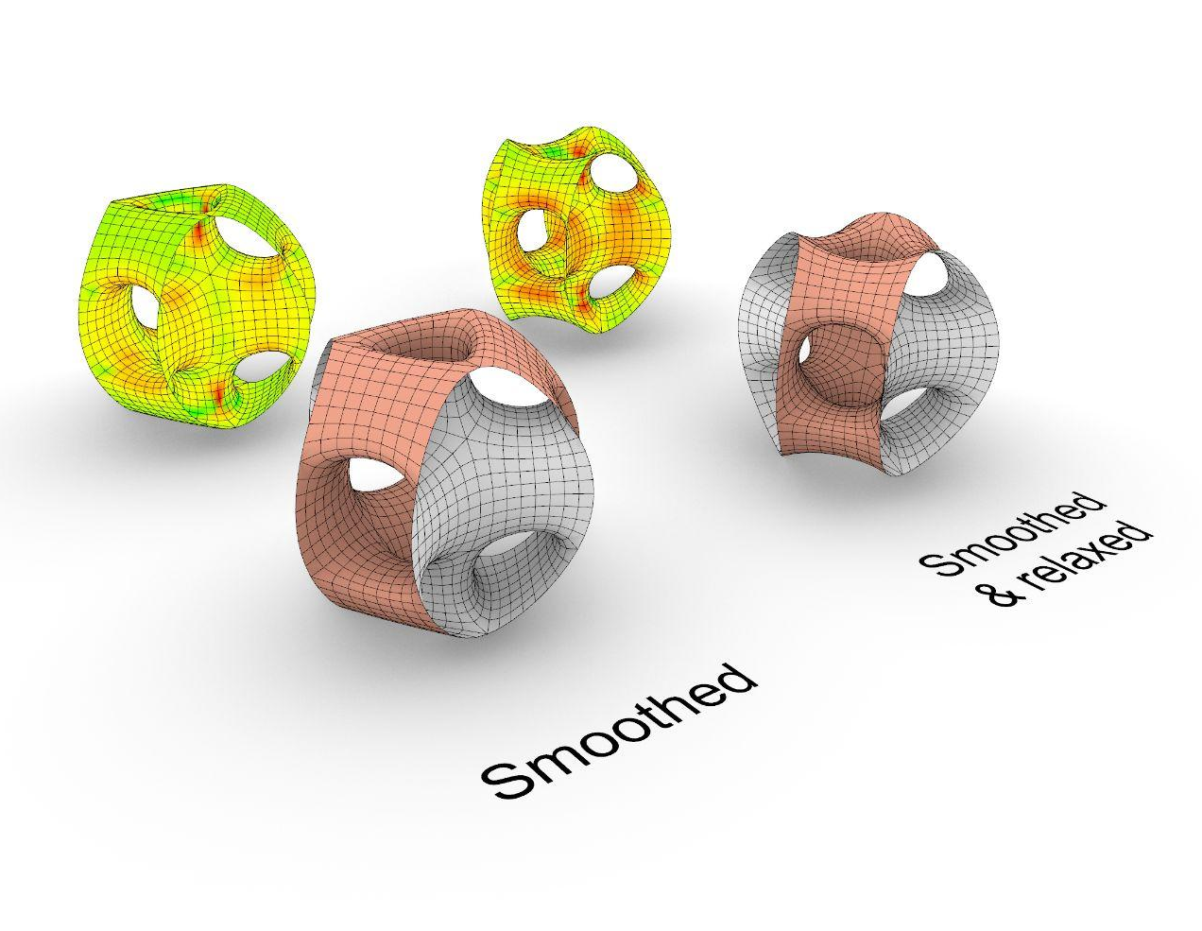
2. Relaxation Exploration
Text styles
Smoothing via Weaverbird’s Catmull-Clark Subdivision, 3 subdivisions per face (L=3), naked edges smooth (S=1).
Relaxation via Zombie solver, threshold 0.00001, tolerance 0.0001
edge length factor 0.7, strength 5
Anchor points: naked boundary edges (783 points)
To avoid inconsistencies, keep these text styles throughout your presentation. Preserve font and size - color can vary to match your graphic palette if necessary.
The increased curvature of the relaxed model can be seen by comparing the meshes.
Further, forces are already evenly distributed by smoothing, and compression increases with relaxation. For fabrication, we need to form find the lowest distribution of forces.
Therefore, we will move forward without using relaxation, and using only smoothing.
Title - Open Sans Normal 36 + Italic
Subtitle - Open Sans SemiBold 24 + Italic
paragraph - Times New Roman 20 + Italic
caption - Open Sans Light 18 + Italic
callout and data in graphics - Times New Roman 14 + Italic
Grace Boyle, Alberto Martínez, Abanoub Nagy

Slide 8
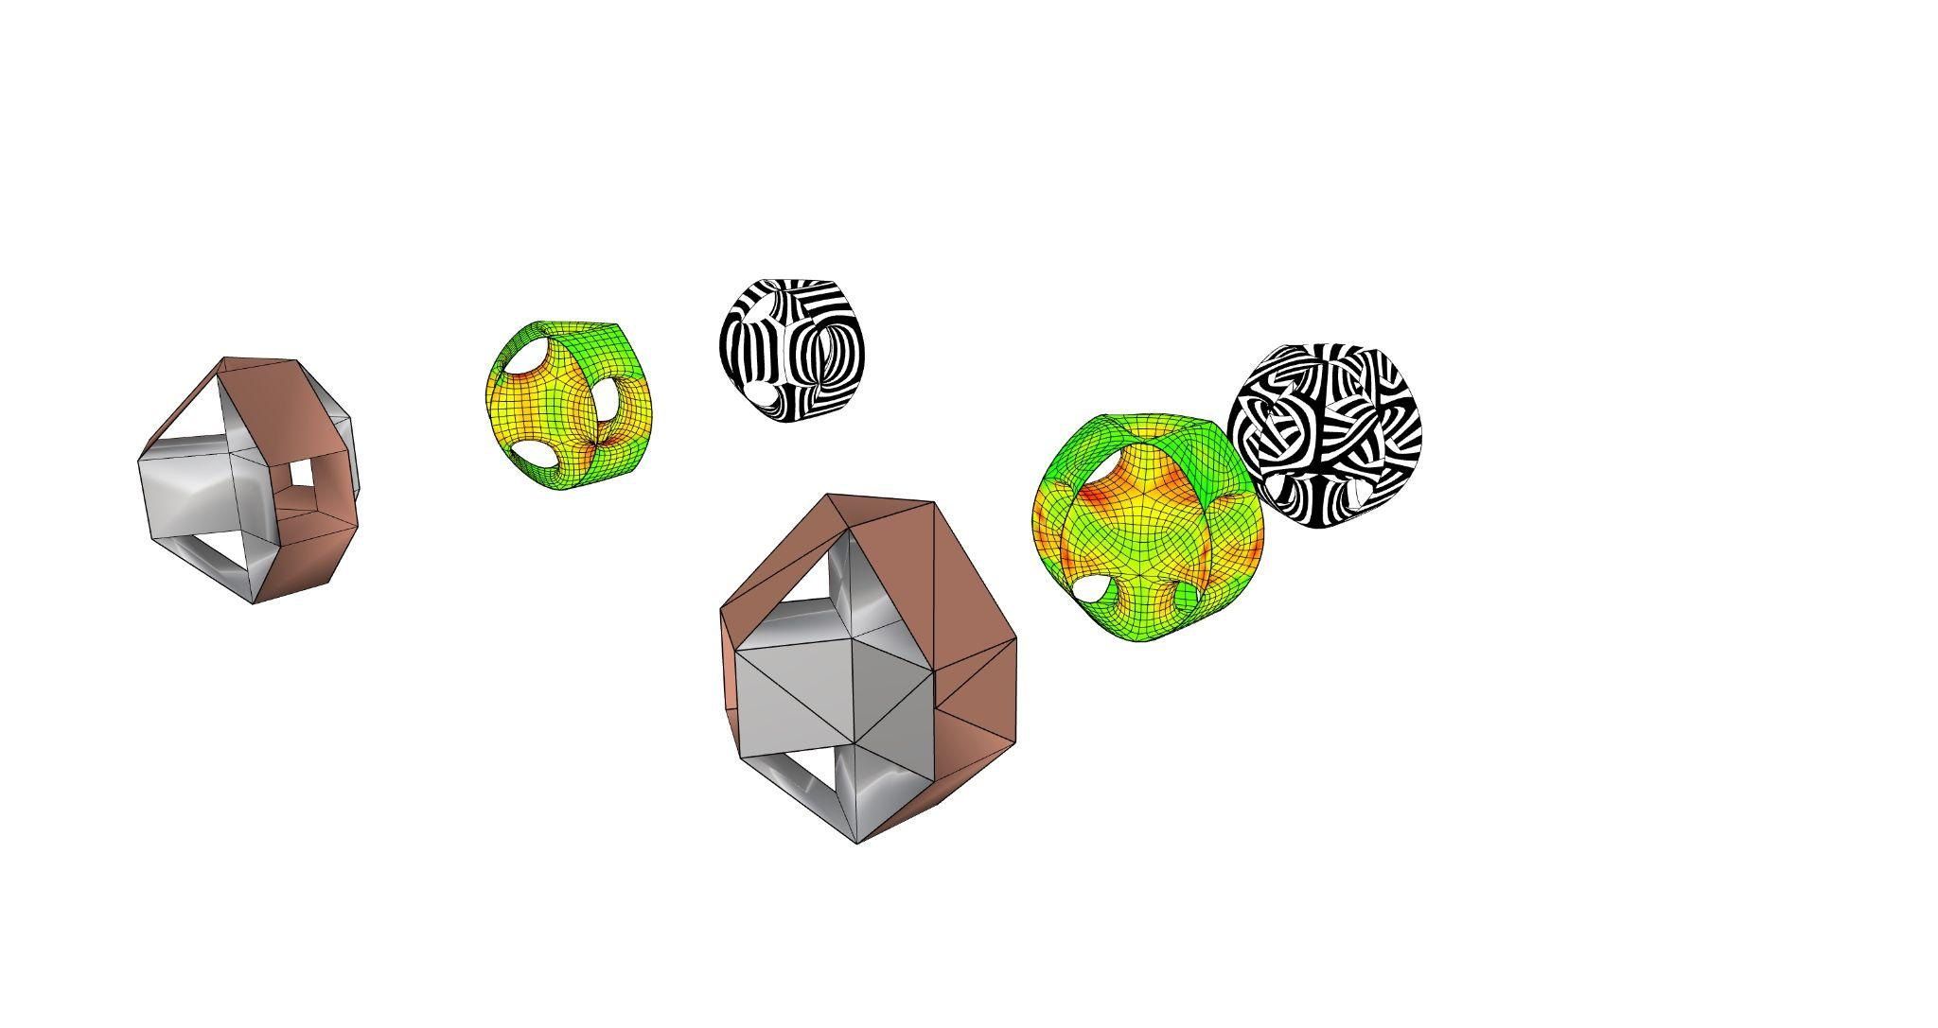
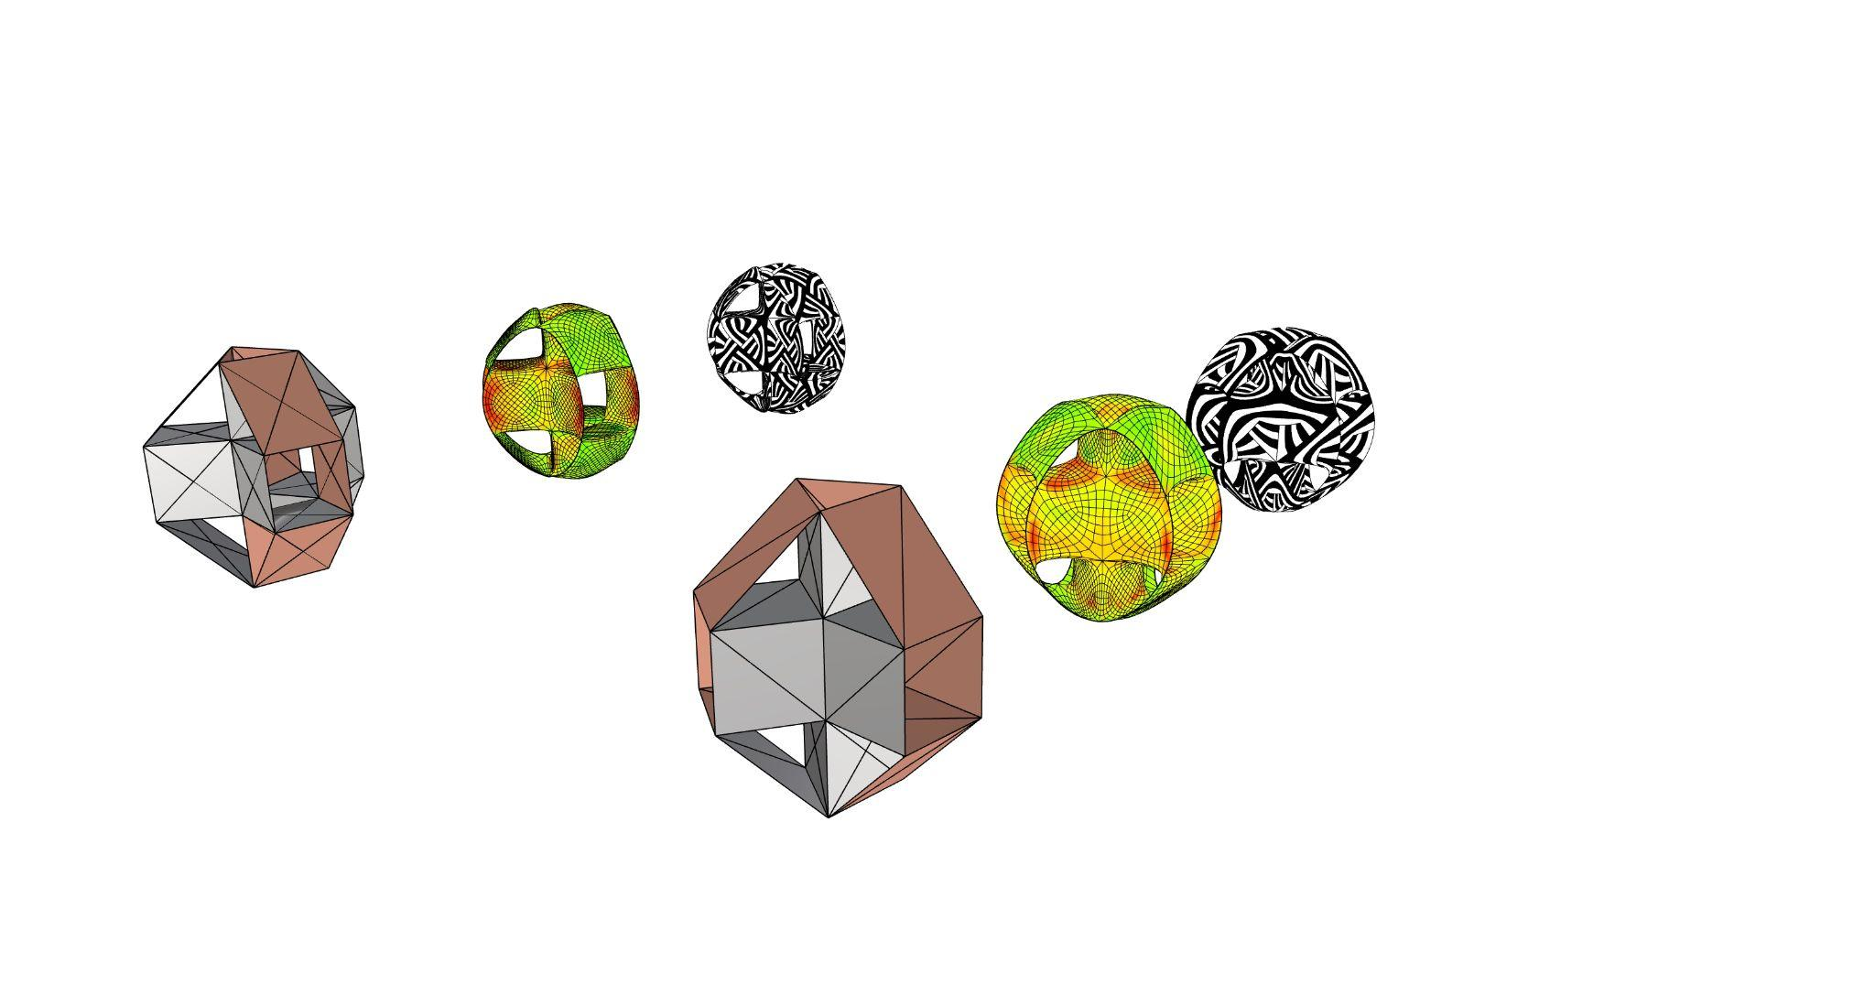
2. Mesh topologies
Text styles
To avoid inconsistencies, keep these text styles throughout your presentation. Preserve font and size - color can vary to match your graphic palette if necessary.
Title - Open Sans Normal 36 + Italic
Subtitle - Open Sans SemiBold 24 + Italic
paragraph - Times New Roman 20 + Italic
caption - Open Sans Light 18 + Italic
callout and data in graphics - Times New Roman 14 + Italic
Subdivision A
Subdivision B
Subdivision C
Subdivision D
Grace Boyle, Alberto Martínez, Abanoub Nagy

Slide 9
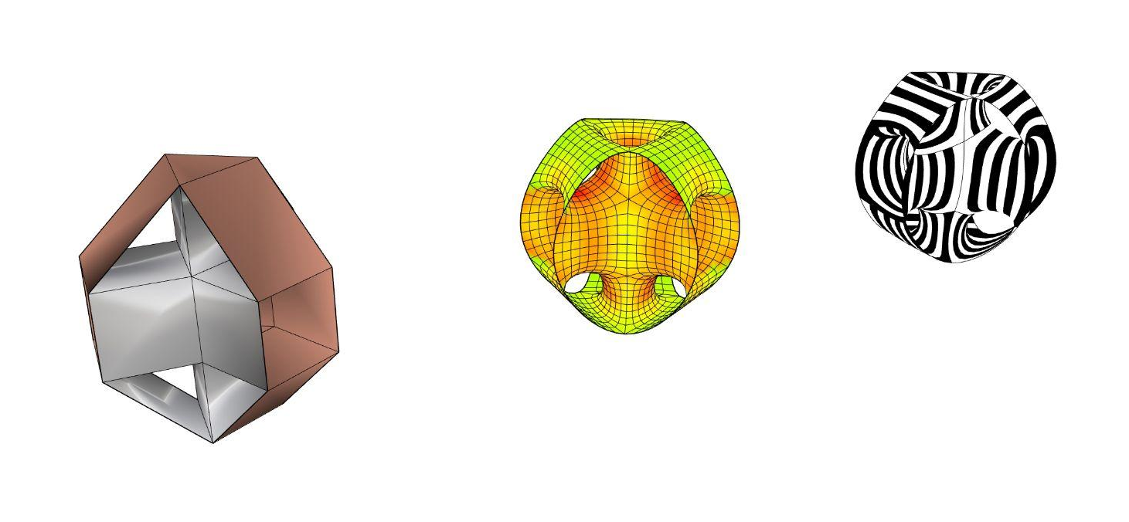
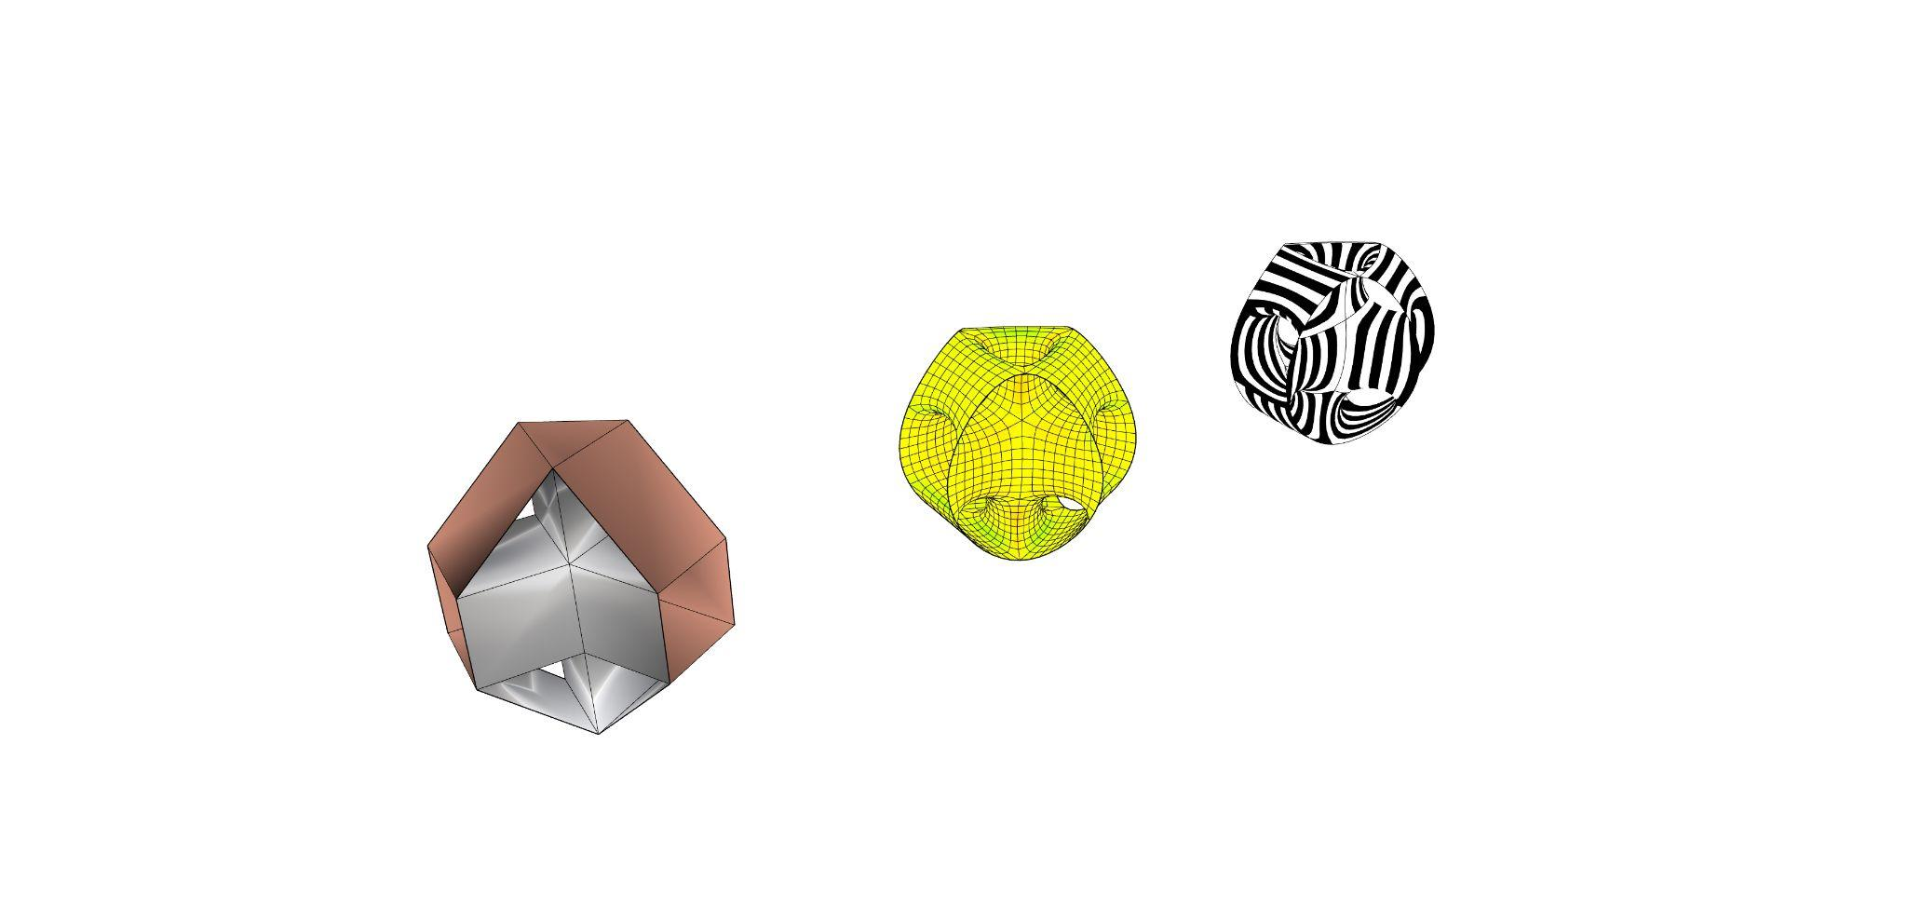
2. Mesh topologies
Text styles
To avoid inconsistencies, keep these text styles throughout your presentation. Preserve font and size - color can vary to match your graphic palette if necessary.
Subdivision A
Title - Open Sans Normal 36 + Italic
Subtitle - Open Sans SemiBold 24 + Italic
paragraph - Times New Roman 20 + Italic
caption - Open Sans Light 18 + Italic
callout and data in graphics - Times New Roman 14 + Italic
Smoothed mesh with stripes applied
Mesh with smoothing and curvature analysis shading
Initial coarse mesh with quad faces
Grace Boyle, Alberto Martínez, Abanoub Nagy

Slide 10
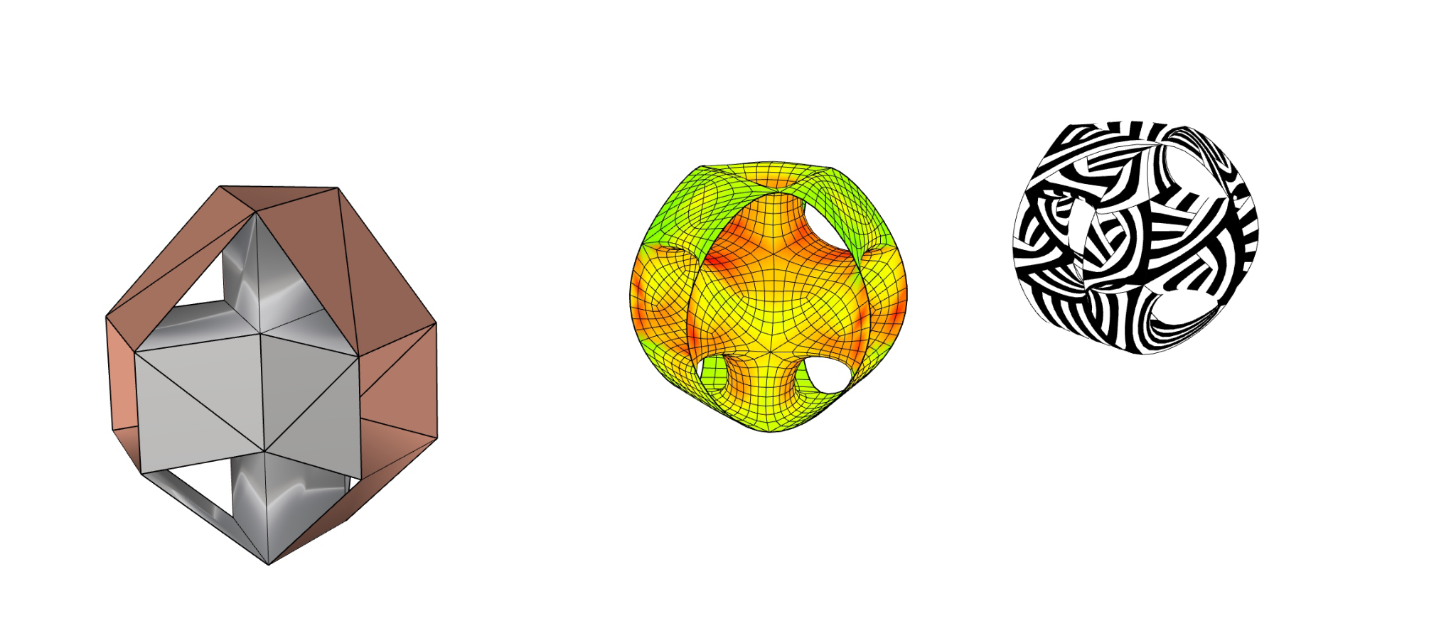
2. Mesh topologies
Text styles
To avoid inconsistencies, keep these text styles throughout your presentation. Preserve font and size - color can vary to match your graphic palette if necessary.
Subdivision B
Title - Open Sans Normal 36 + Italic
Subtitle - Open Sans SemiBold 24 + Italic
paragraph - Times New Roman 20 + Italic
caption - Open Sans Light 18 + Italic
callout and data in graphics - Times New Roman 14 + Italic
Complex stripe patterns begin to appear. Flow of stripes seems to have more potential in the core rather than on the loops.
Smoothed mesh in curvature analysis shows less force along triangle edges, but more compression at apex of triangles and on adjacent quad faces
Coarse mesh with some quad faces subdivided to 2 triangles
Grace Boyle, Alberto Martínez, Abanoub Nagy

Slide 11
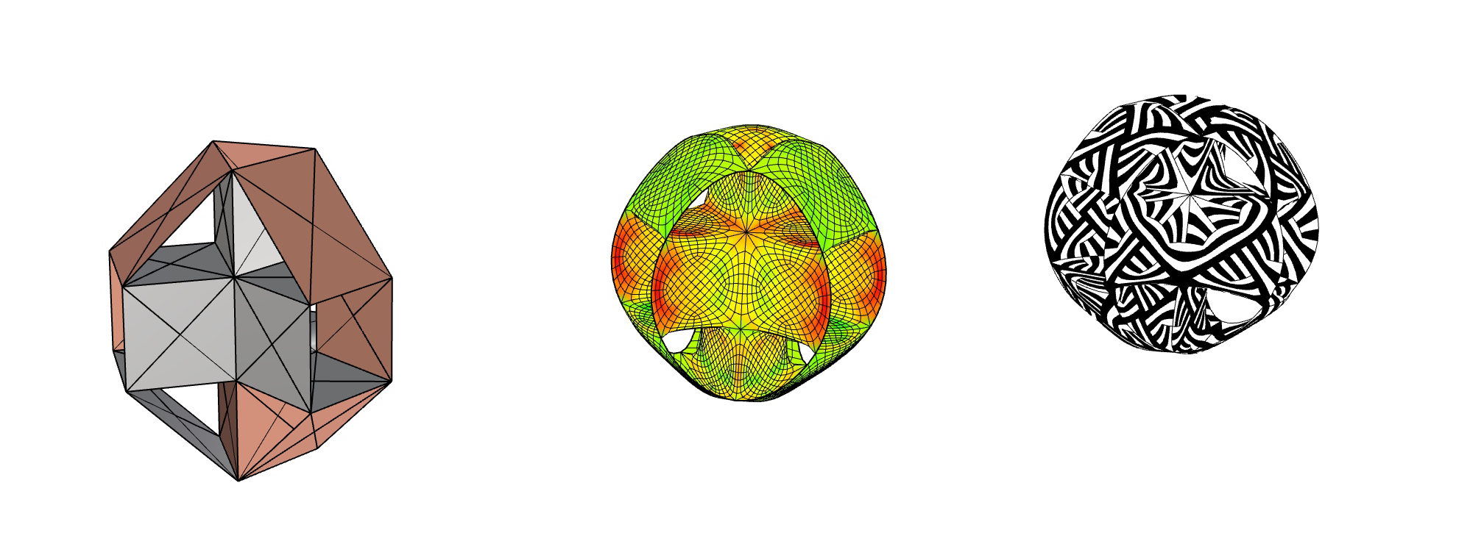
2. Mesh topologies
Text styles
To avoid inconsistencies, keep these text styles throughout your presentation. Preserve font and size - color can vary to match your graphic palette if necessary.
Subdivision C
Title - Open Sans Normal 36 + Italic
Subtitle - Open Sans SemiBold 24 + Italic
paragraph - Times New Roman 20 + Italic
caption - Open Sans Light 18 + Italic
callout and data in graphics - Times New Roman 14 + Italic
Stripe patterns become so complex it can be difficult to distinguish the geometry
Forces more distributed on loops, more compression in core
Coarse mesh with some quad faces subdivided to 4 triangles
Grace Boyle, Alberto Martínez, Abanoub Nagy

Slide 12
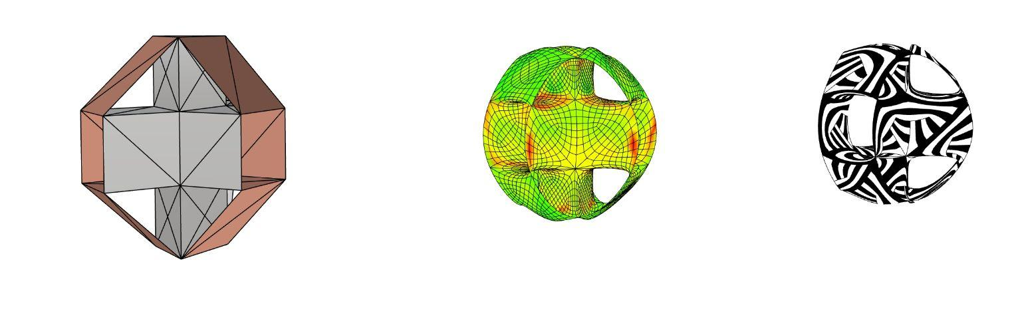
2. Mesh topologies
Text styles
To avoid inconsistencies, keep these text styles throughout your presentation. Preserve font and size - color can vary to match your graphic palette if necessary.
Subdivision D
Title - Open Sans Normal 36 + Italic
Subtitle - Open Sans SemiBold 24 + Italic
paragraph - Times New Roman 20 + Italic
caption - Open Sans Light 18 + Italic
callout and data in graphics - Times New Roman 14 + Italic
Complex striping pattern
Smoothed mesh in curvature analysis
Coarse mesh with some quad faces subdivided to 2 triangles, some to 4 triangles
Grace Boyle, Alberto Martínez, Abanoub Nagy

Slide 13
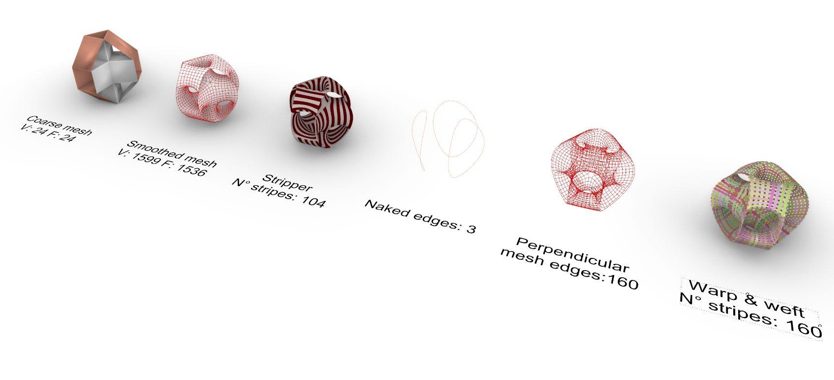
3. Stripes method
Text styles
To avoid inconsistencies, keep these text styles throughout your presentation. Preserve font and size - color can vary to match your graphic palette if necessary.
Title - Open Sans Normal 36 + Italic
Subtitle - Open Sans SemiBold 24 + Italic
paragraph - Times New Roman 20 + Italic
caption - Open Sans Light 18 + Italic
callout and data in graphics - Times New Roman 14 + Italic
The symmetry and looping of the geometry create good potential for both warp & weft and stripes.
Grace Boyle, Alberto Martínez, Abanoub Nagy

Slide 14
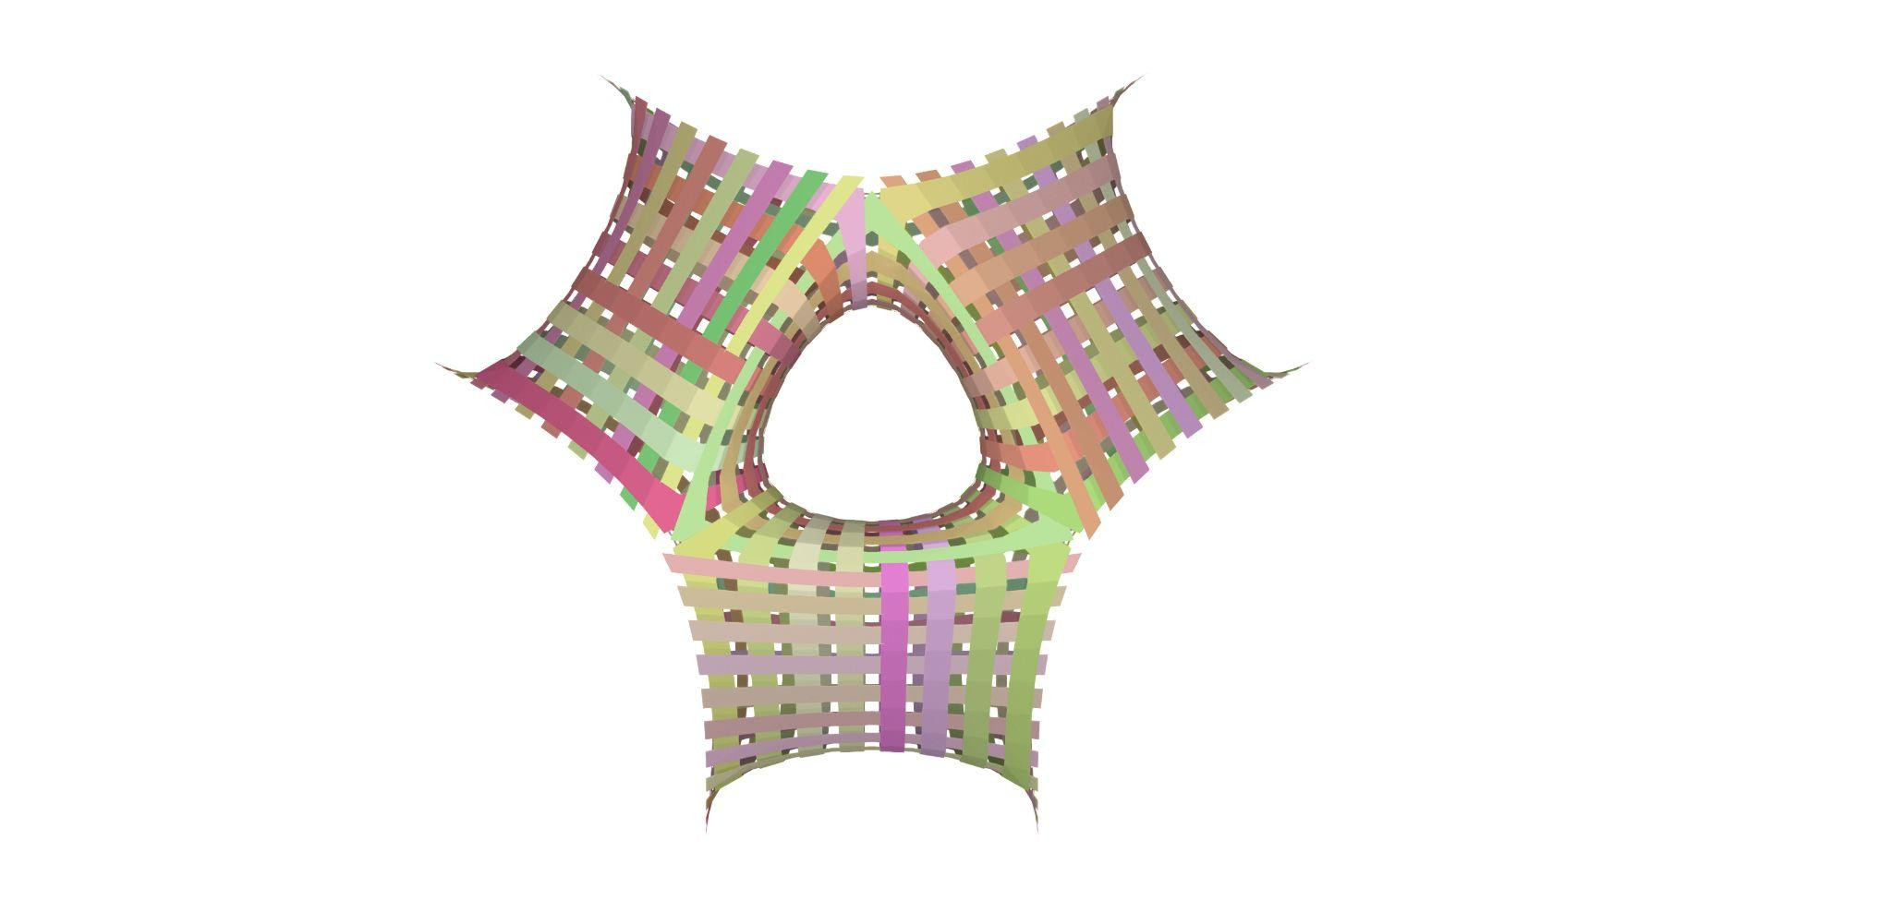
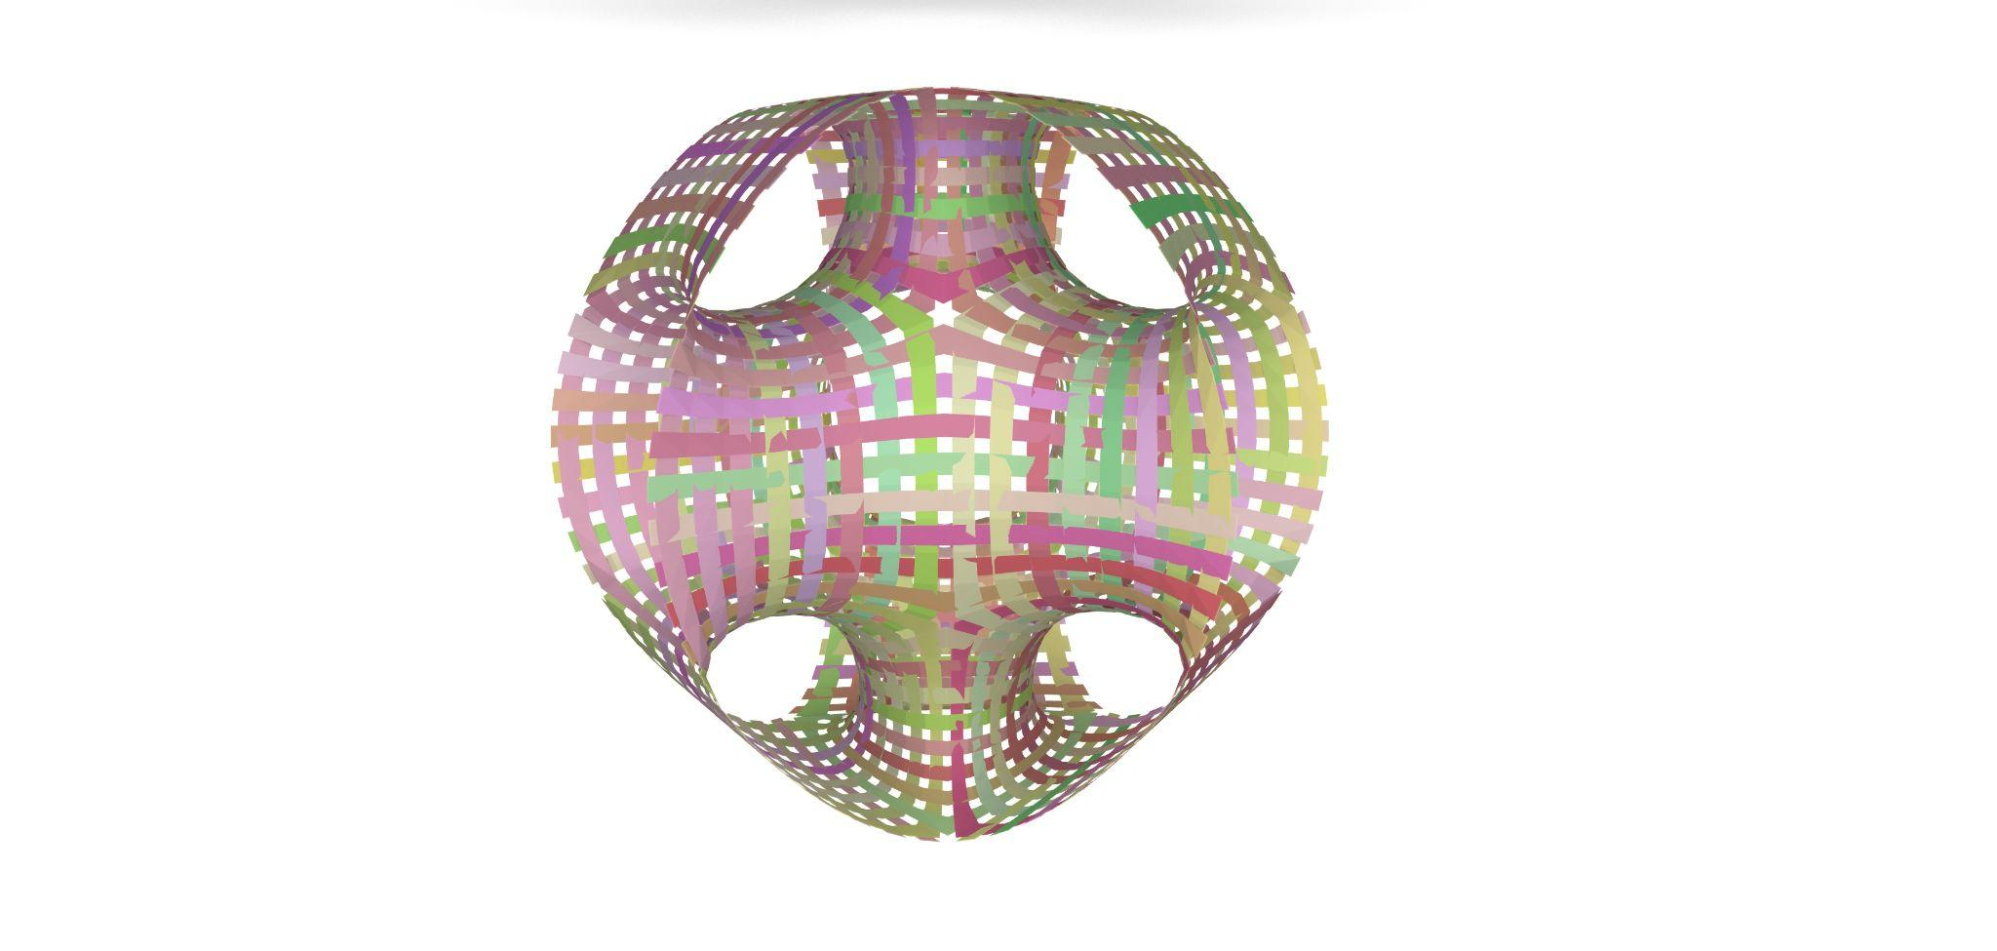
3. Warp & weft analysis
Text styles
To avoid inconsistencies, keep these text styles throughout your presentation. Preserve font and size - color can vary to match your graphic palette if necessary.
Title - Open Sans Normal 36 + Italic
Subtitle - Open Sans SemiBold 24 + Italic
paragraph - Times New Roman 20 + Italic
caption - Open Sans Light 18 + Italic
callout and data in graphics - Times New Roman 14 + Italic
Warp & weft,
top view
Warp & weft,
angled front view
This could be a very nice construction in a flexible material such as plastic or textile, with the five openings fixed to create tension. Interwoven strips around the loops in the geometry would be robust.
On this occasion, as our pavilion will be made of aluminium, which is a rigid material and less suited to interweaving, stripes are selected for the mesh design.
Grace Boyle, Alberto Martínez, Abanoub Nagy

Slide 15
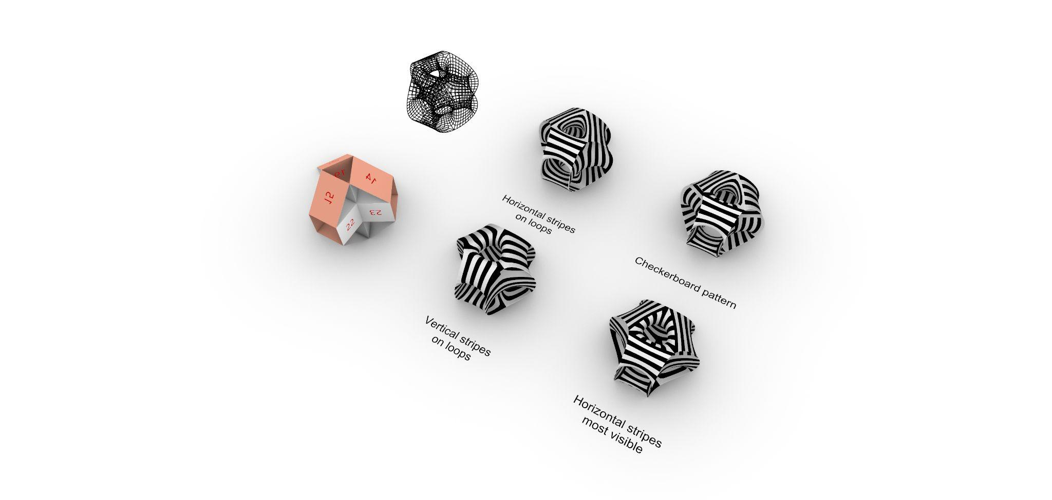
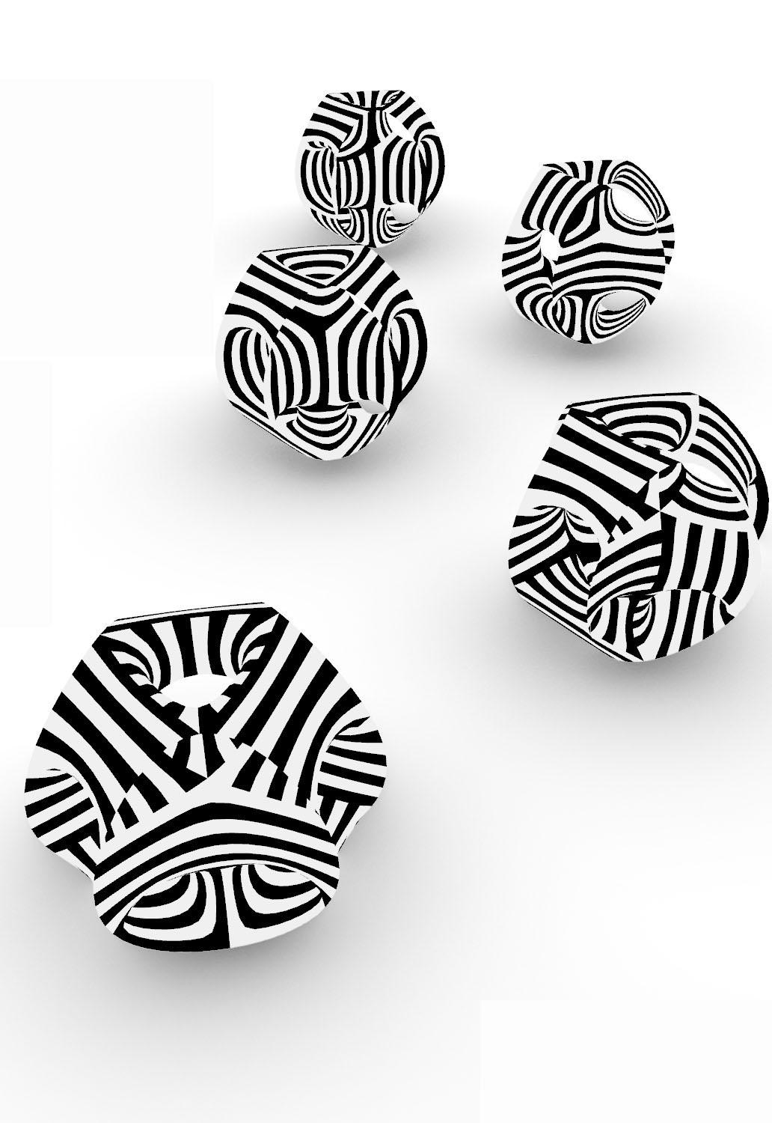
4. Quad face stripe topologies
Original
3
1
1
2
2
4
3
¾ View
4
Grace Boyle, Alberto Martínez, Abanoub Nagy

Slide 16
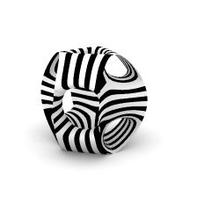
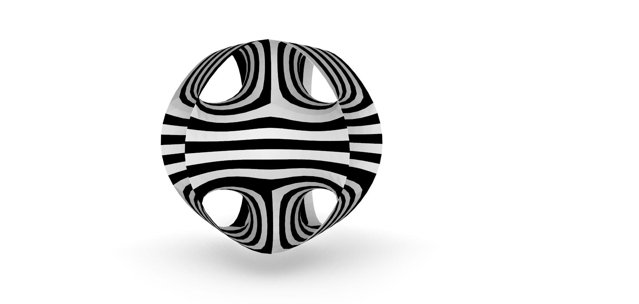
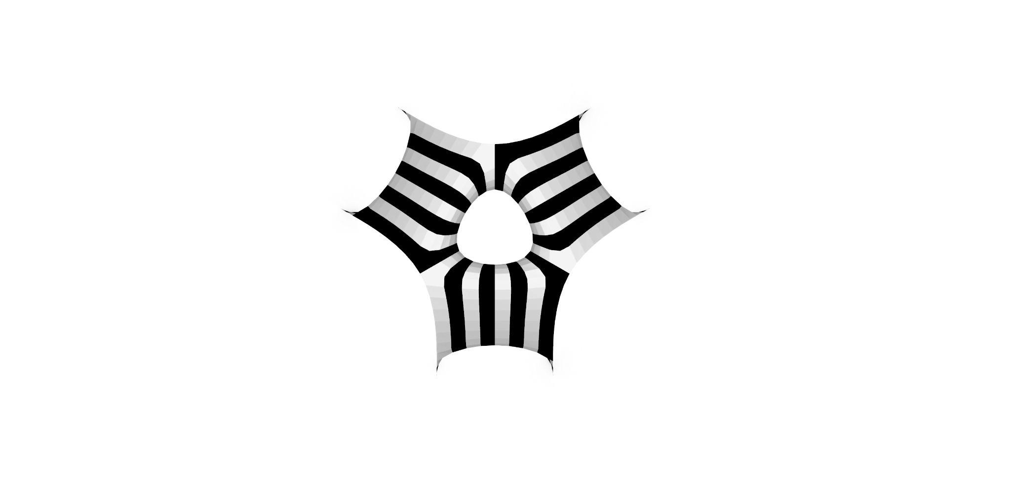
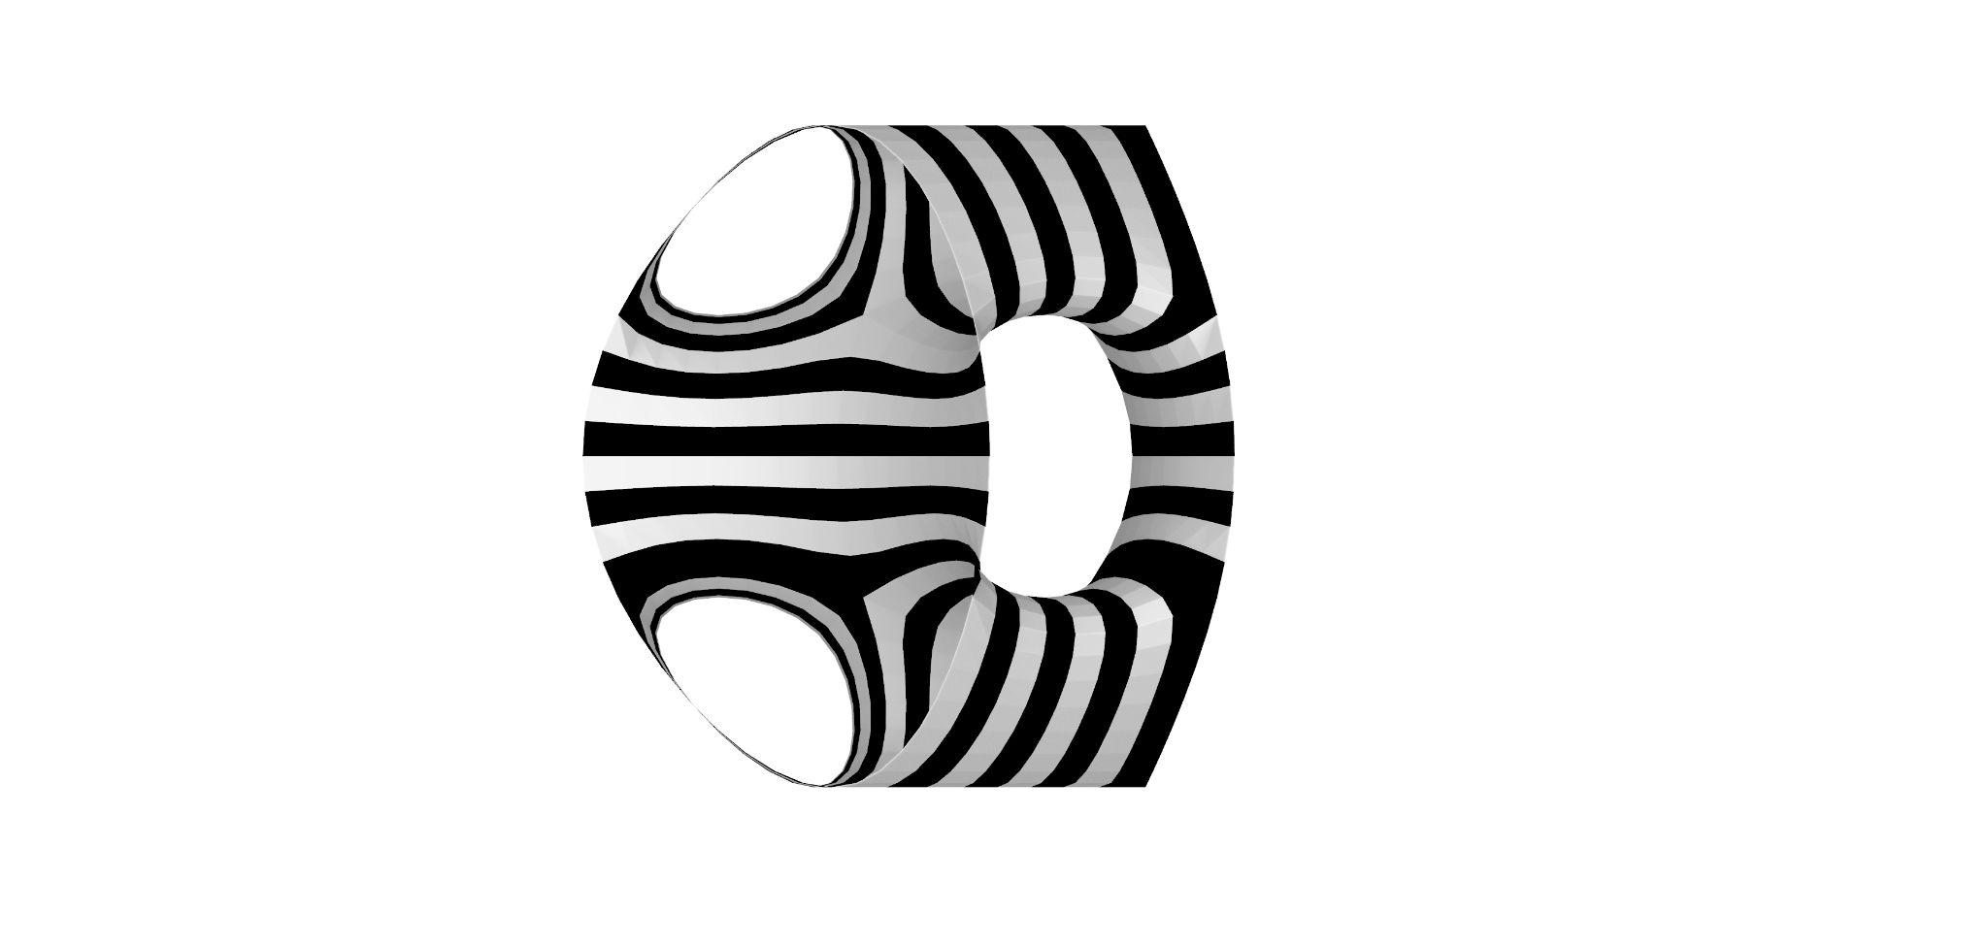
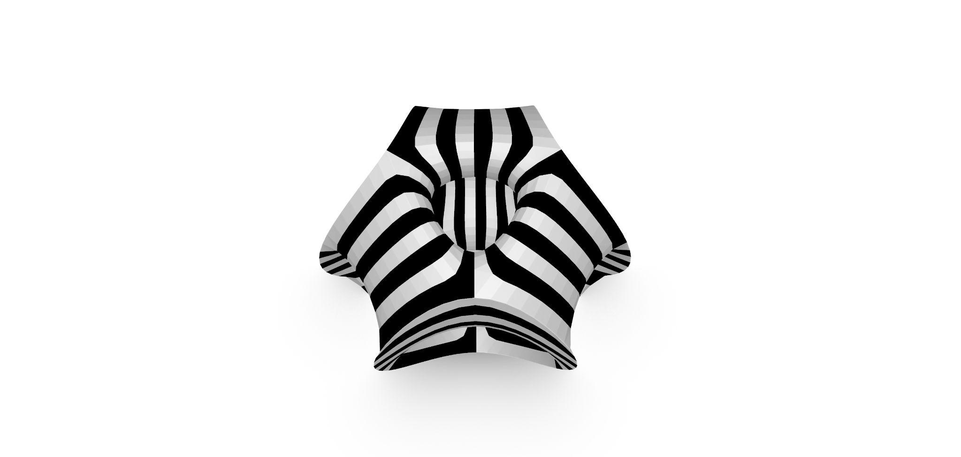
5. Chosen mesh topology
Top view
Angled front view
into core
Corner geometry suits the triangularly subdivided stripes, as they can wrap around them. On this shape we have no outward corners, but a prominent feature of looping over vertices. This is better suited to quad face stripes as, once orientated, they can flow beautifully with the geometry.
Right side view. Continuous stripe flow is absorbing and gives illusion of shape distortion
Angled top view. Orientation gives apparent continuity of stripes across different vertical levels
Grace Boyle, Alberto Martínez, Abanoub Nagy

Slide 17
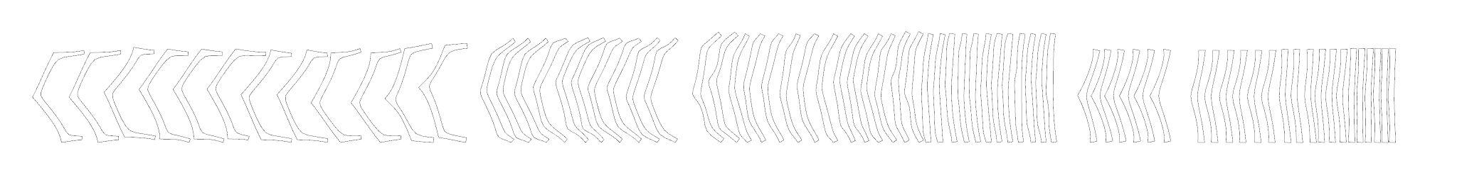
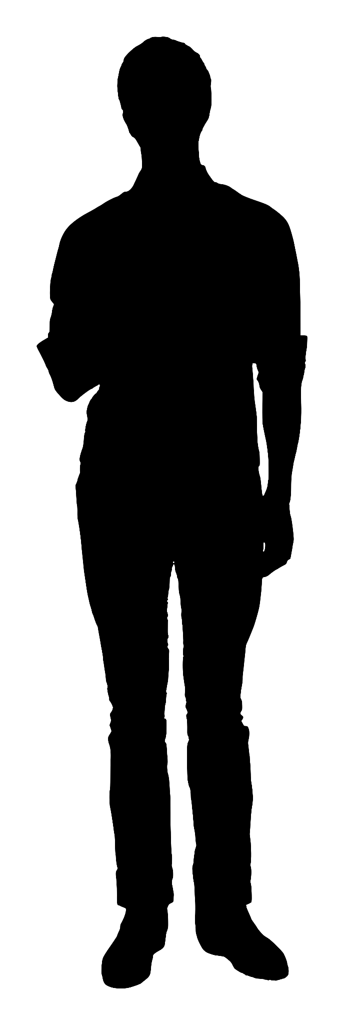
6. Strip planarization and nesting
No. pieces: 72
Length of pieces: 3,1-3,6m
Total weight: 142,37 kg*
These are all the pieces needed to build the structure after unrolling the stripes generated by the design.
Labelled strip planarization by sizes and groups:
A1-A12
B1-B10
C1-C26
D1-D6
E1-E18
Group A
12 pieces
Average A = 6.878,28 cm²
Average m = 1,49 kg
Total m = 17,88 kg
Group B
10 pieces
Average A = 7.048,56 cm²
Average m = 1,52 kg
Total m = 15,2 kg
Group C
26 pieces
Average A = 10.848,9 cm²
Average m = 275,02 g
Total m = 7,15 kg
Group D
6 pieces
Average A = 8.994,36 cm²
Average m = 1,94 kg
Total m = 11,64 kg
Group E
18 pieces
Average A = 9.437,64 cm²
Average m = 2,04 kg
Total m = 36,72 kg
*Al-1050 density:
2,7 g/cm³
Grace Boyle, Alberto Martínez, Abanoub Nagy

Slide 18
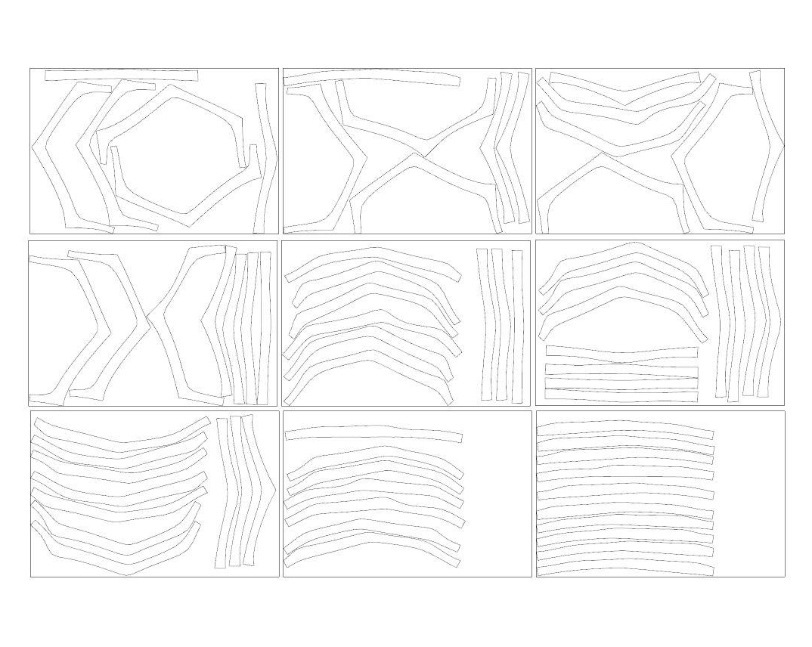
6. Strip planarization and nesting
Components nesting set
No. of sheet metal pieces: 9
Dimensions of every sheet:
A = 516 x 334 cm
Thickness = 0,8 mm
m = 37,23 kg
Total weight of metal sheets: 335,07 kg
Total weight of pieces: 142,37 kg
Used material: 43%
The remaining material will be used for further joint elements.
Grace Boyle, Alberto Martínez, Abanoub Nagy

Slide 19
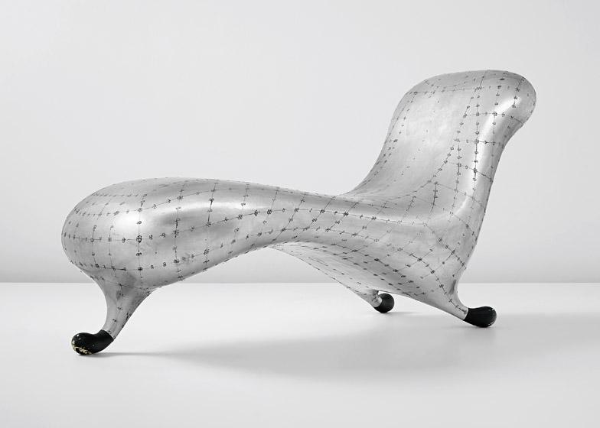
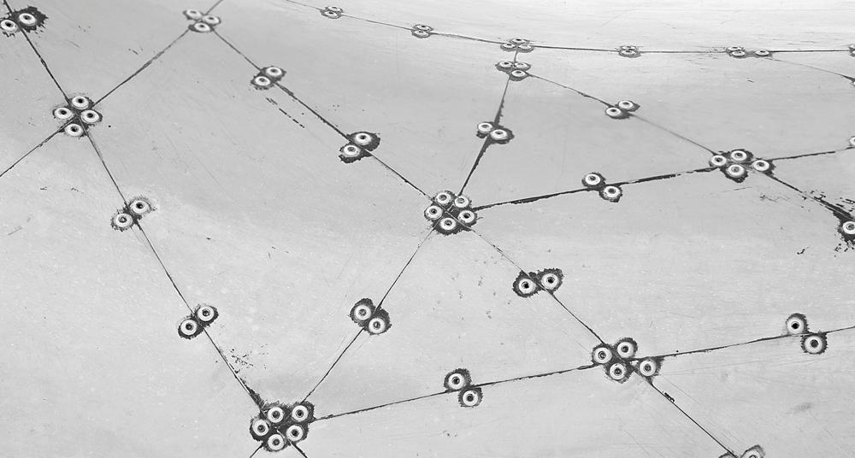
7. Material and Process
Aluminum 1050T pieces.
Laser cut outlines and rivet holes (better than CNC milled as its thickness is less than 1mm)
Pneumatic riveting with d-4mm rivets
Hexagonal joint piece taken from the material cut leftovers. With this single shape a maximum quantity of leftovers will be avoided increasing the joint’s surface area.
Flaps should be studied along every other strip to get an additional joint area between the pieces. Otherwise, the same hexa joint could be used.
100
Marc Newson’s Lockheed Lounge riveting
Grace Boyle, Alberto Martínez, Abanoub Nagy

Slide 20
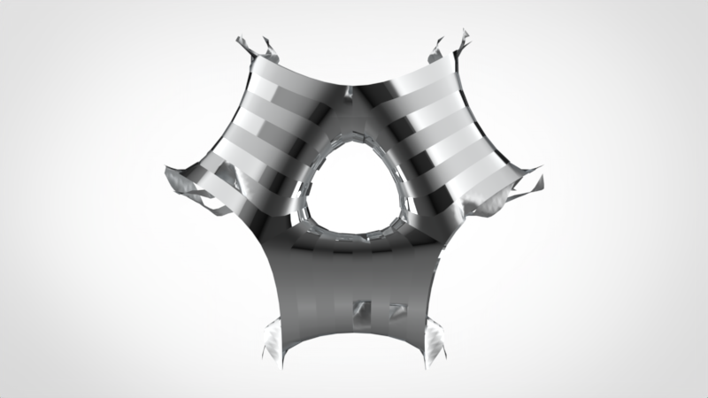
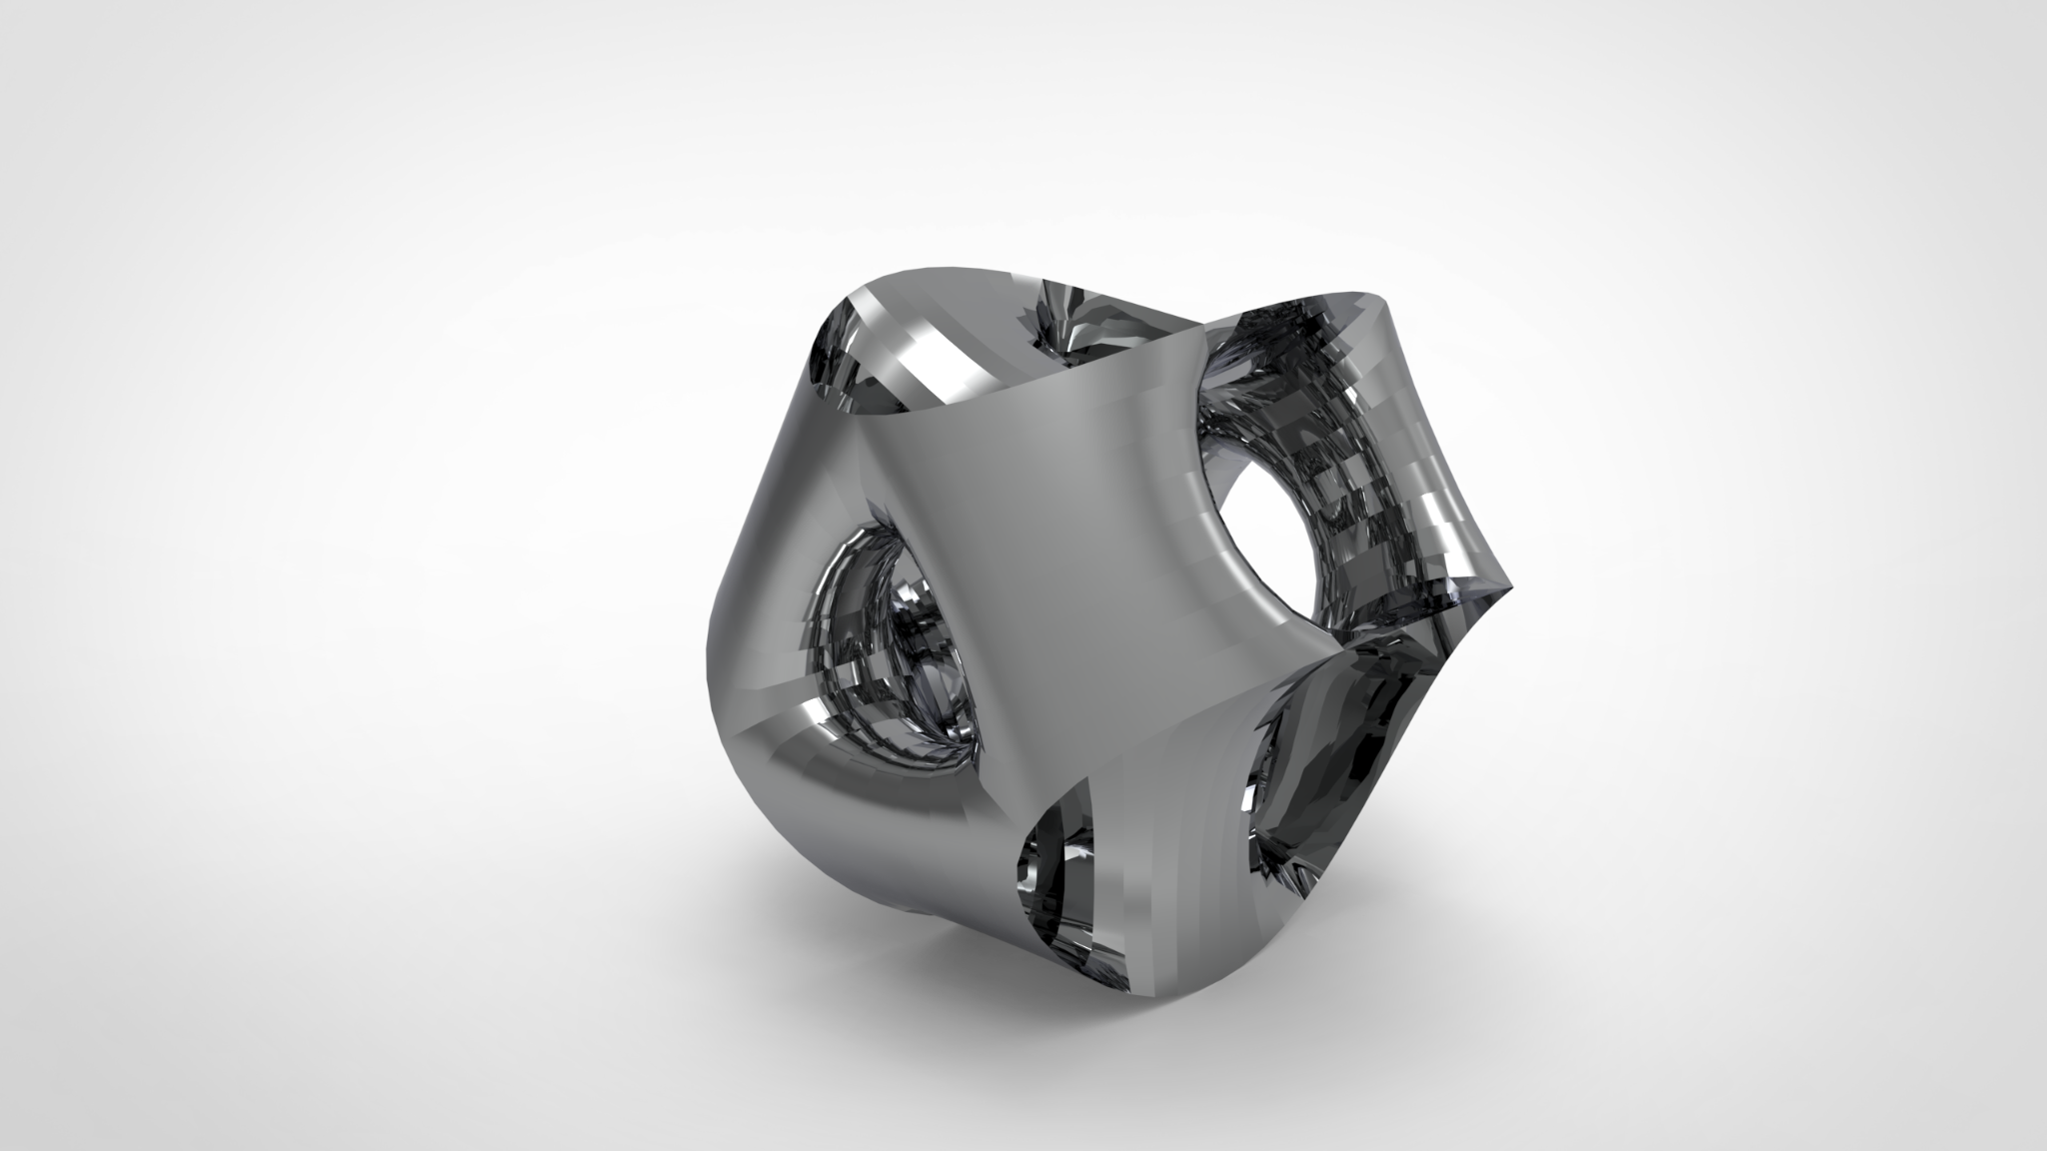
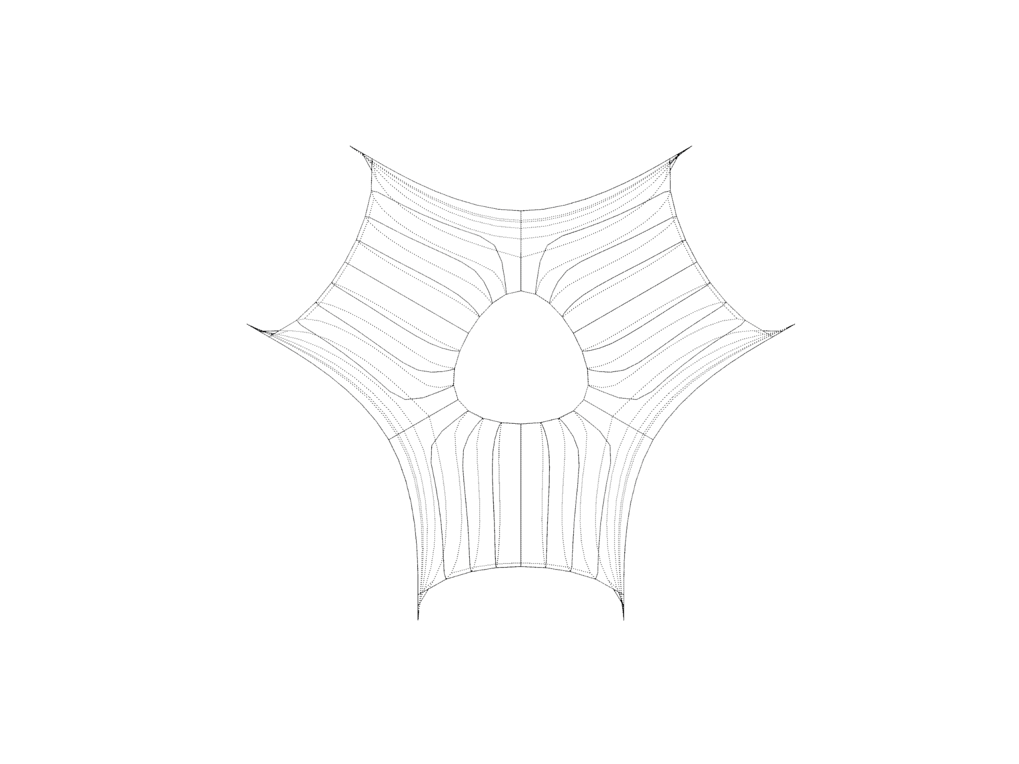
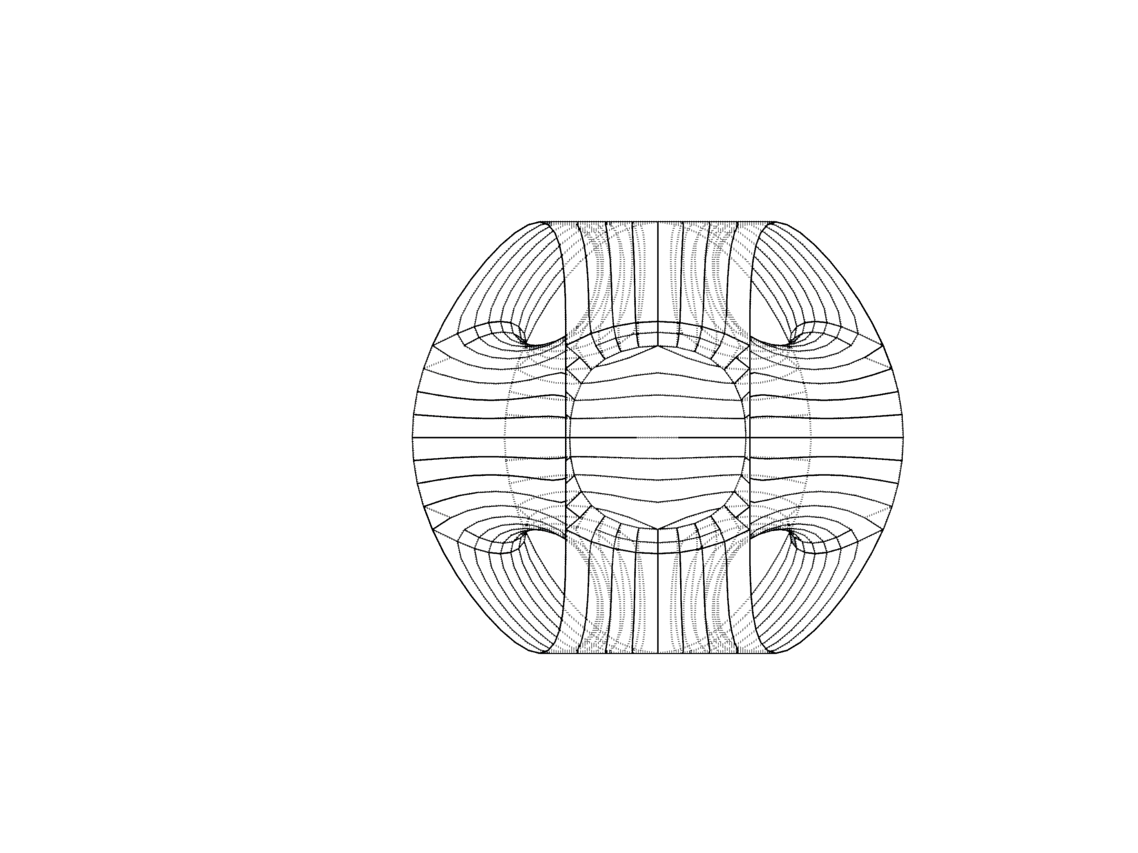
8. Connection system, scale and context
Triple edge mesh wrong
Subdivision-catmull
Flip faces
Strip direction (number vertices, triangle quad)
Interior reinforced with a framed wooden structure.
For a static anchored solution, the material thickness should be increased, as well as the inner structure, turned into metal and fixed to the ground.
Audience will be able to go and see through the construction while rolling it along the way
320 cm
Grace Boyle, Alberto Martínez, Abanoub Nagy

Slide 21
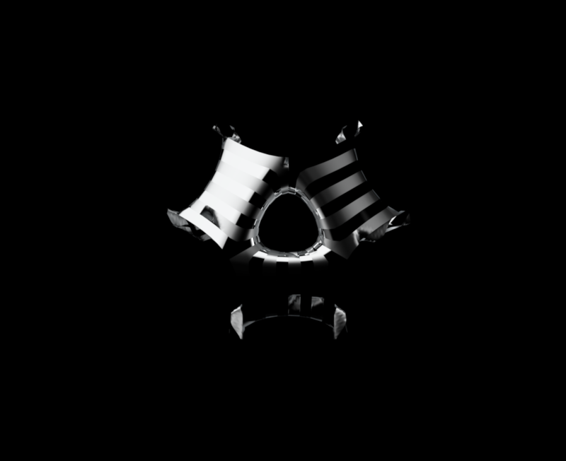
Thank you

Slide 22
10. References
https://bnrc.springeropen.com/articles/10.1186/s42269-019-0231-6
https://www.biobasedpress.eu/2019/09/processed-banana-leaves-an-eco-friendly-packaging-solution/
Images
https://marc-newson.com/lockheed-lounge/
https://www.dezeen.com/2015/04/29/marc-newson-lockheed-lounge-new-auction-record-design-object-phillips/
Grace Boyle, Alberto Martínez, Abanoub Nagy

